Slide 1

Welcome Back Meeting
August 24, 2022

Slide 2
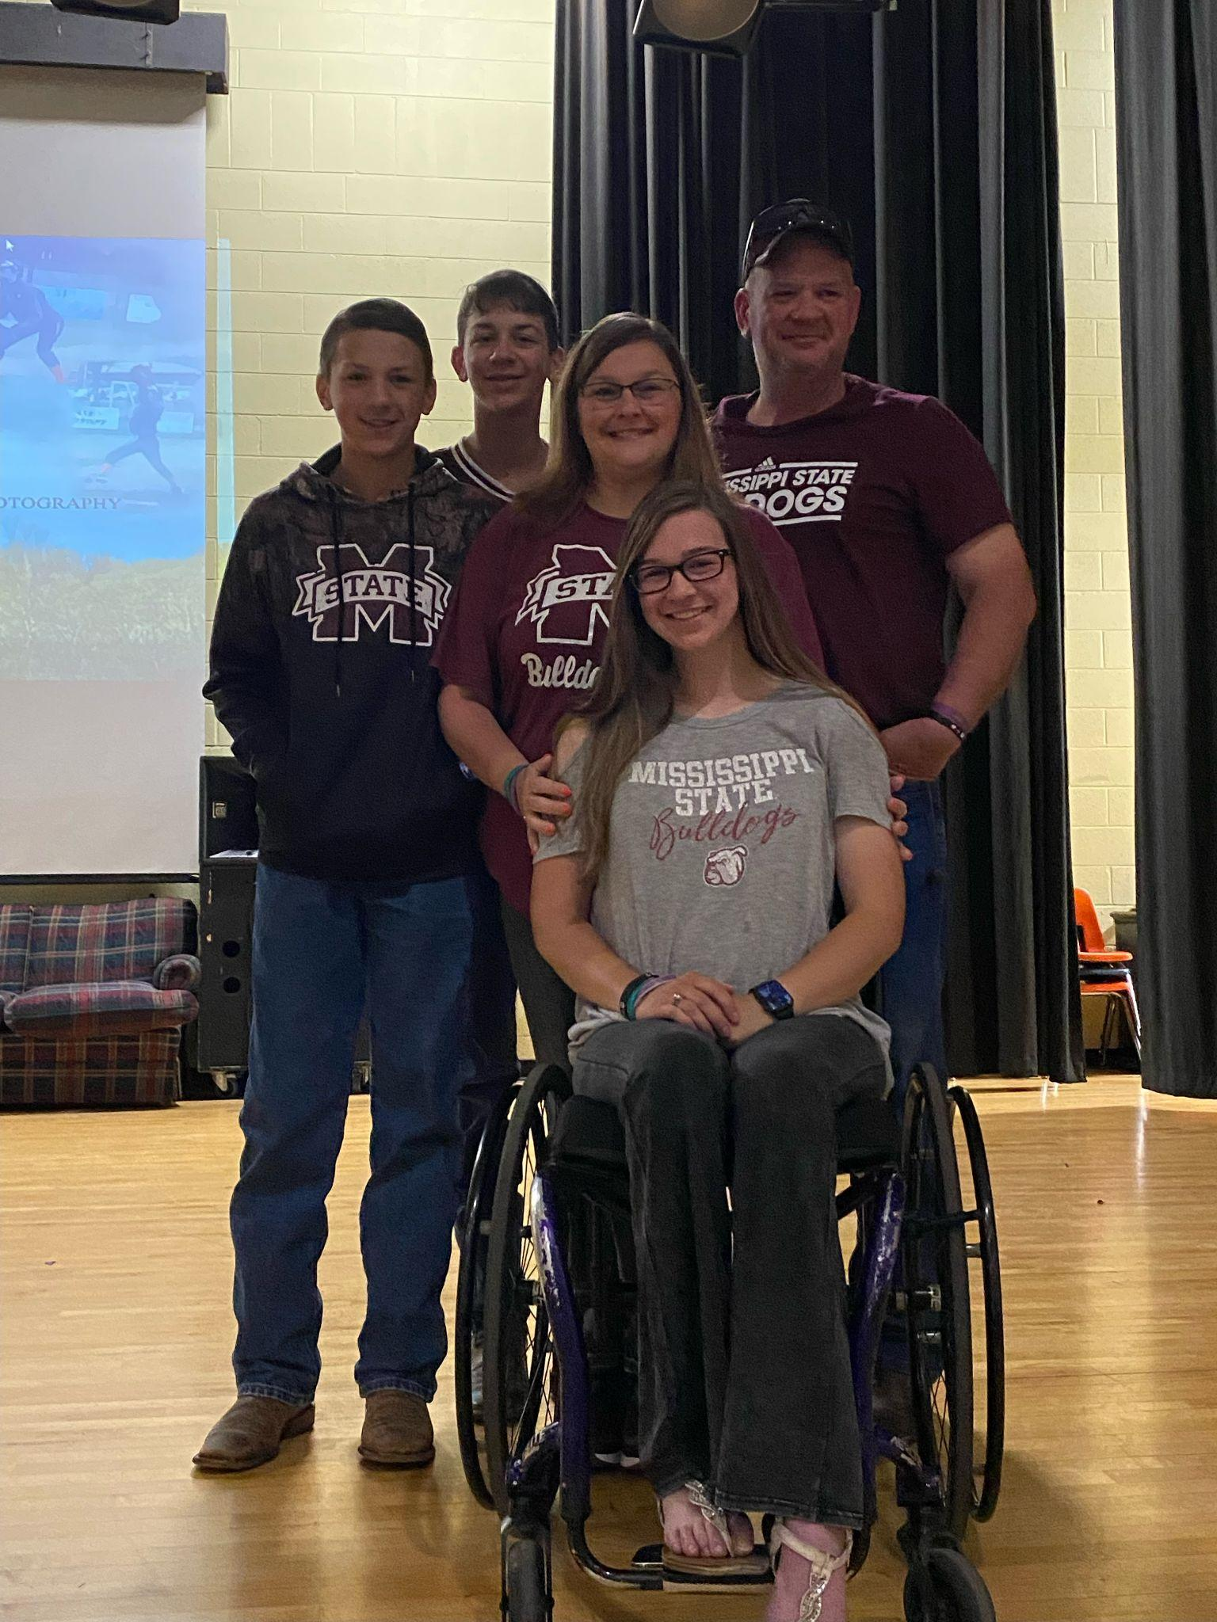
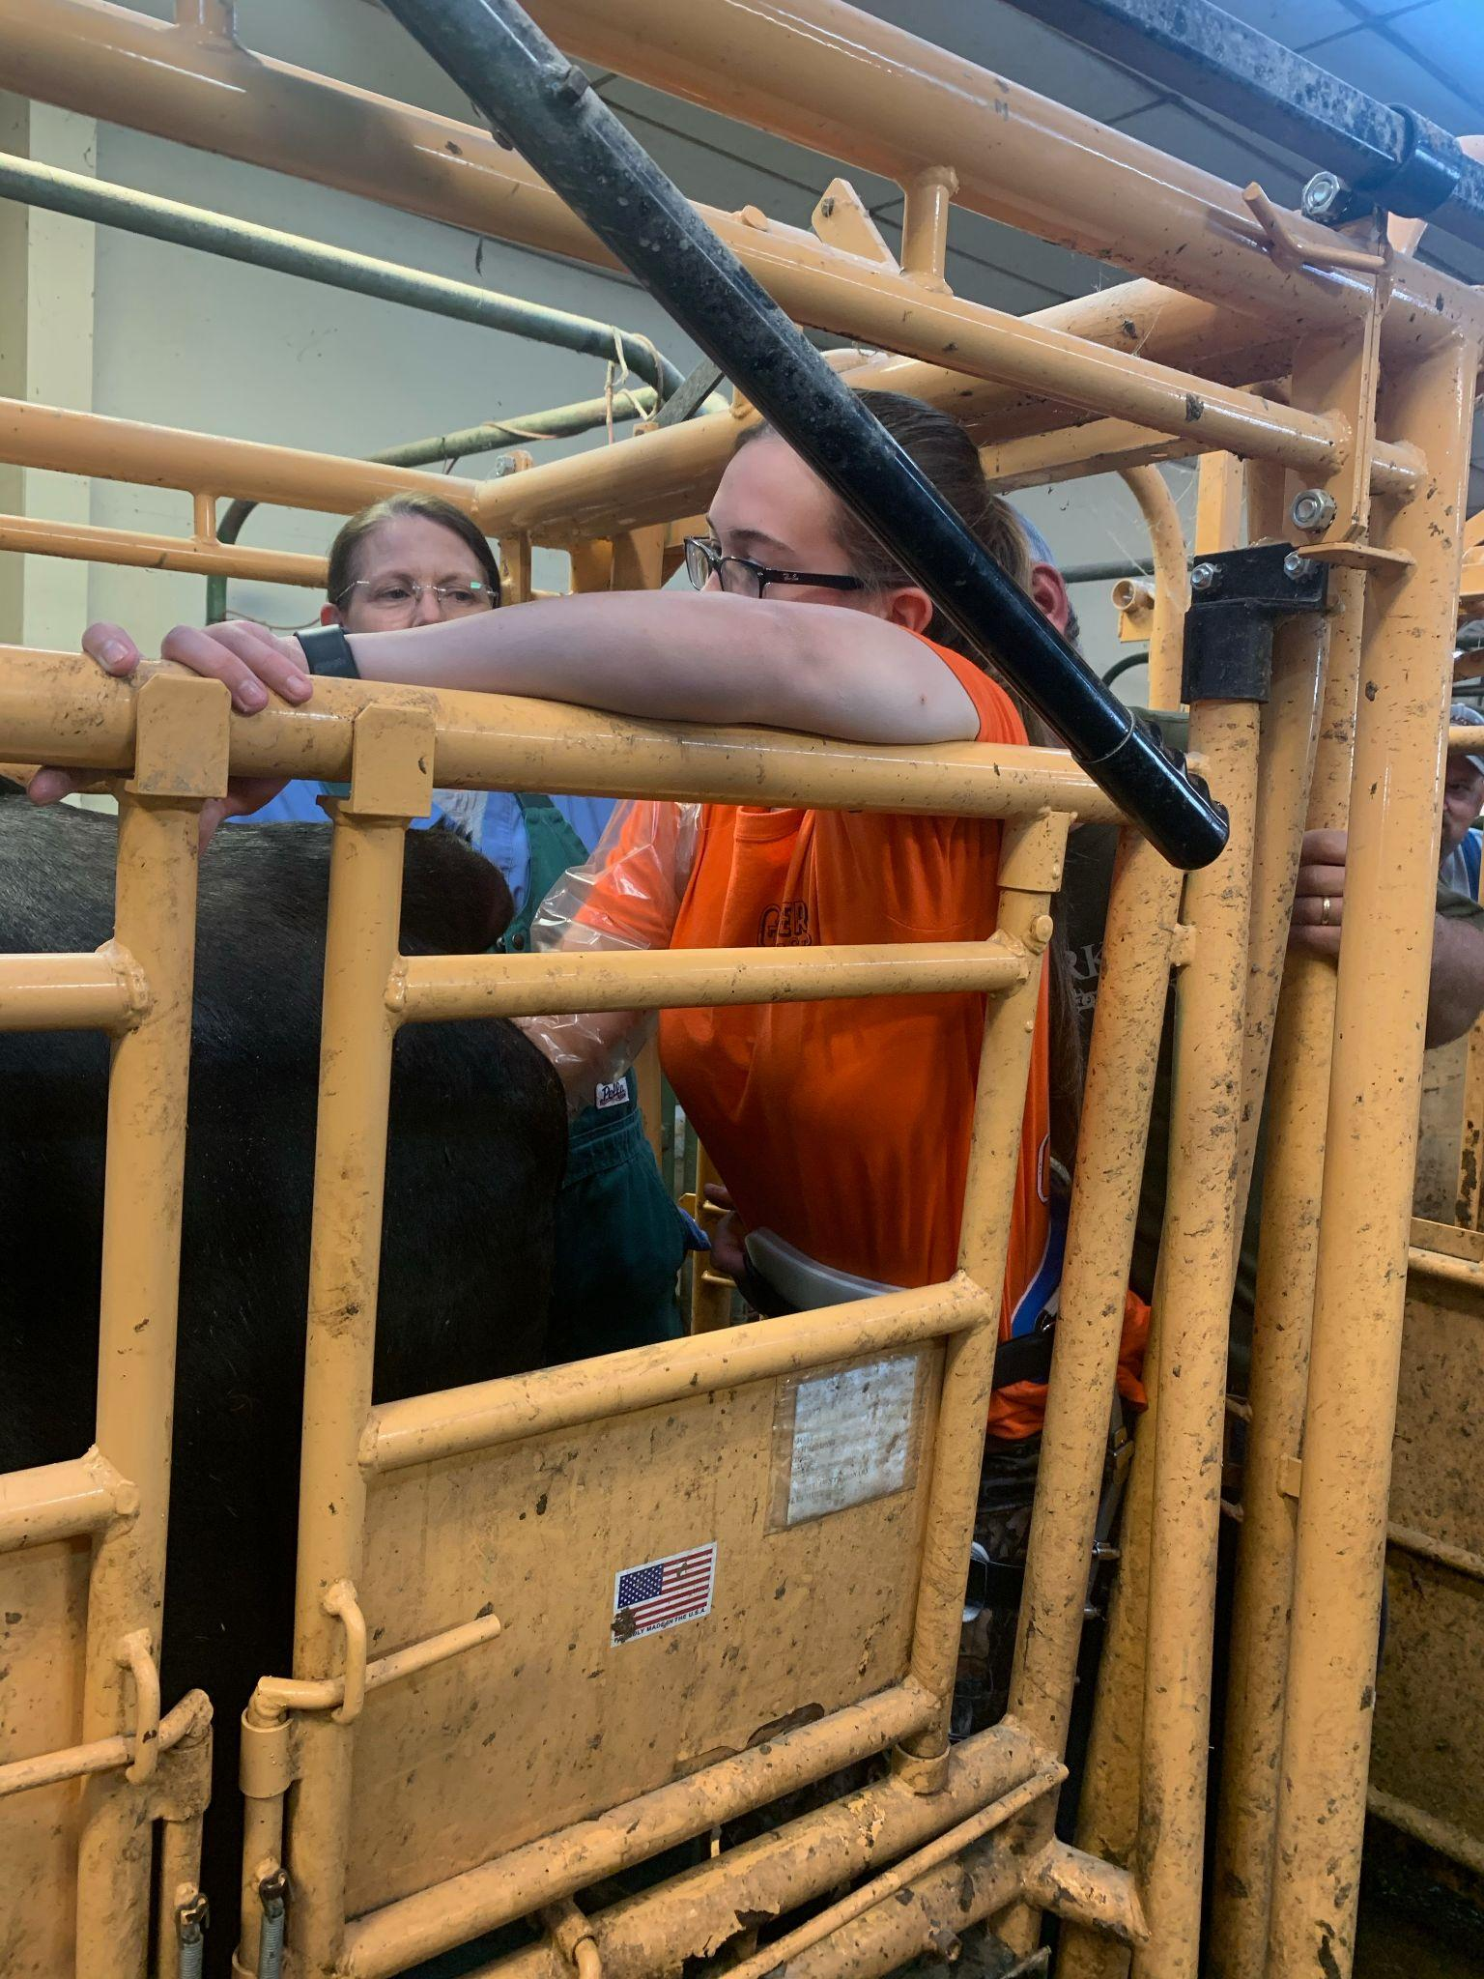
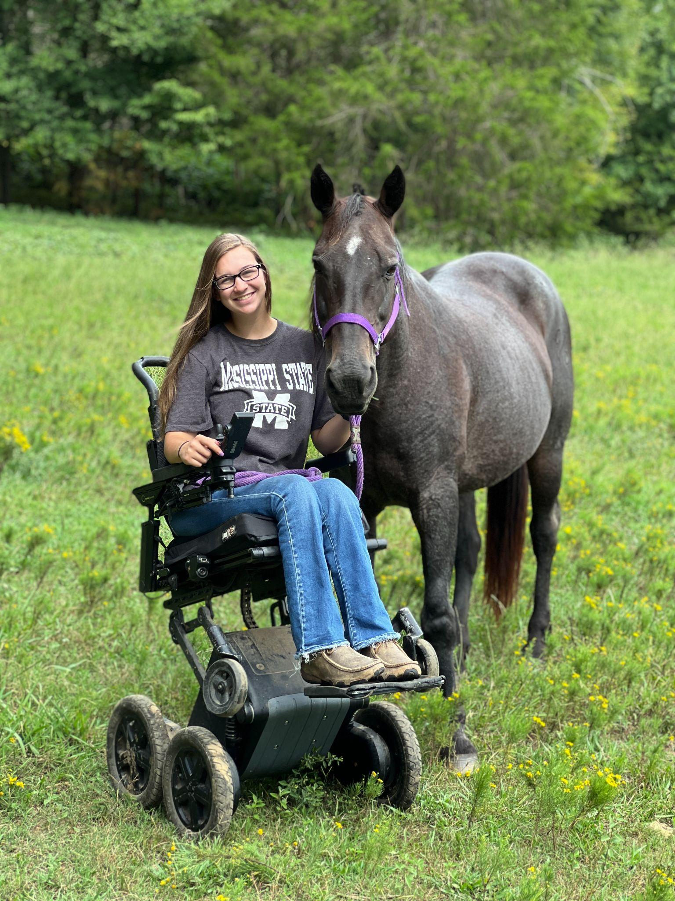
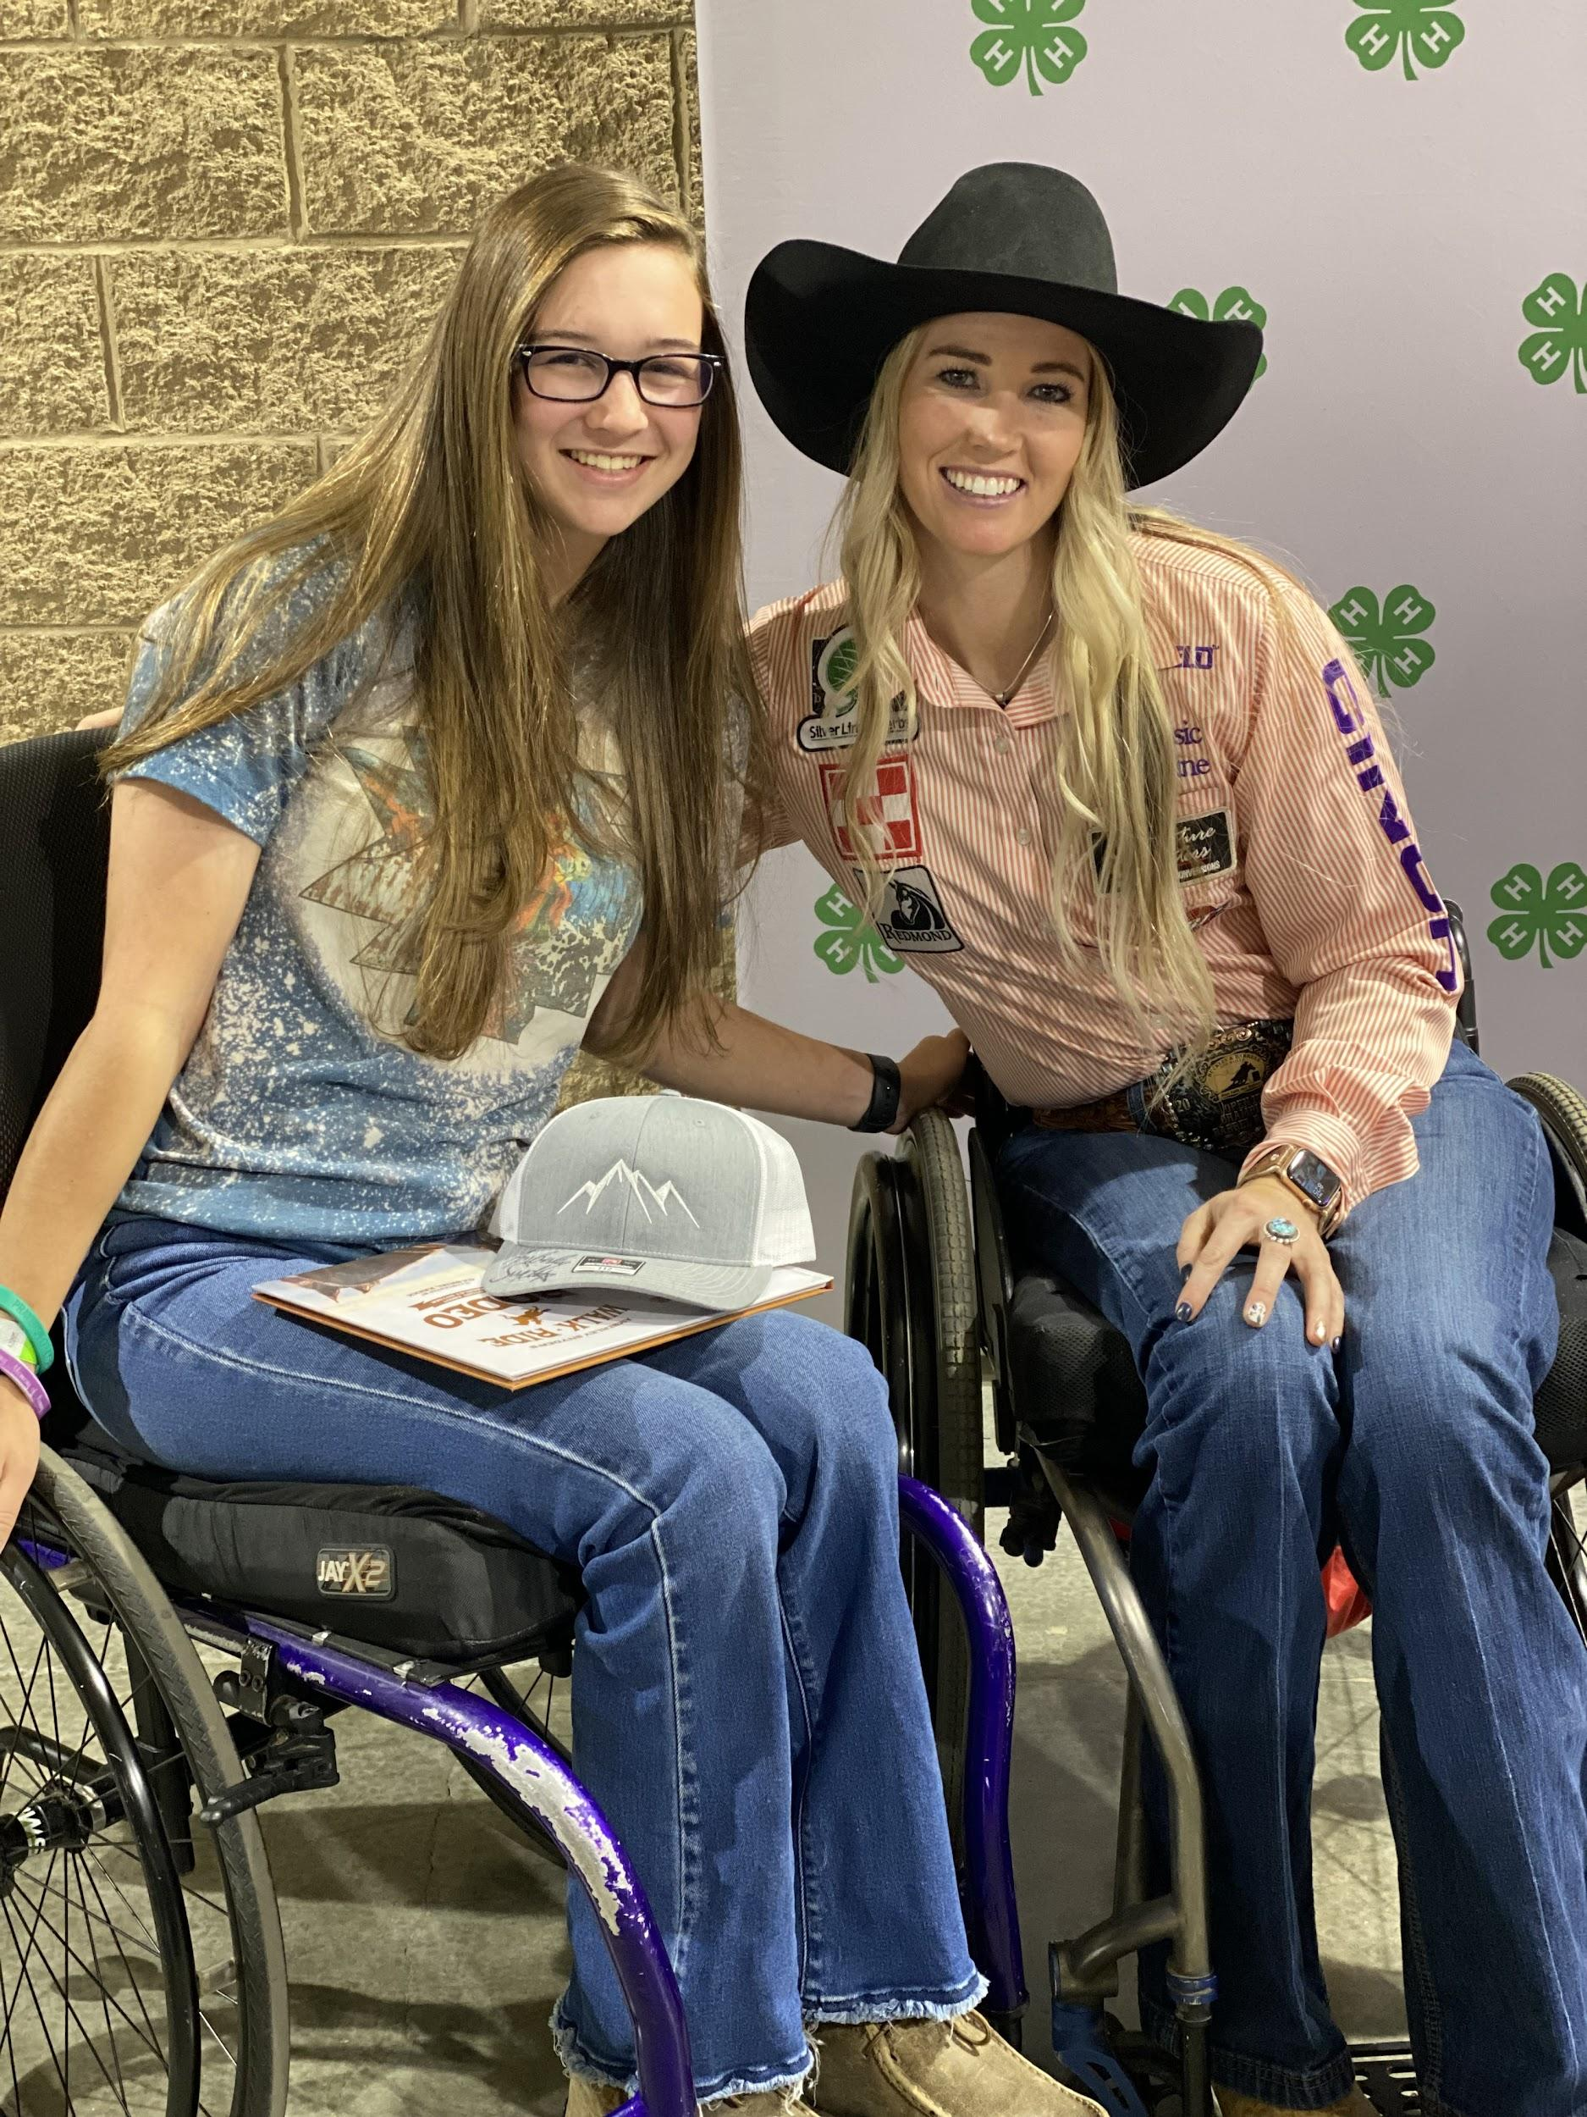

President
Hope Drake
Junior
PVC 2020

Slide 3
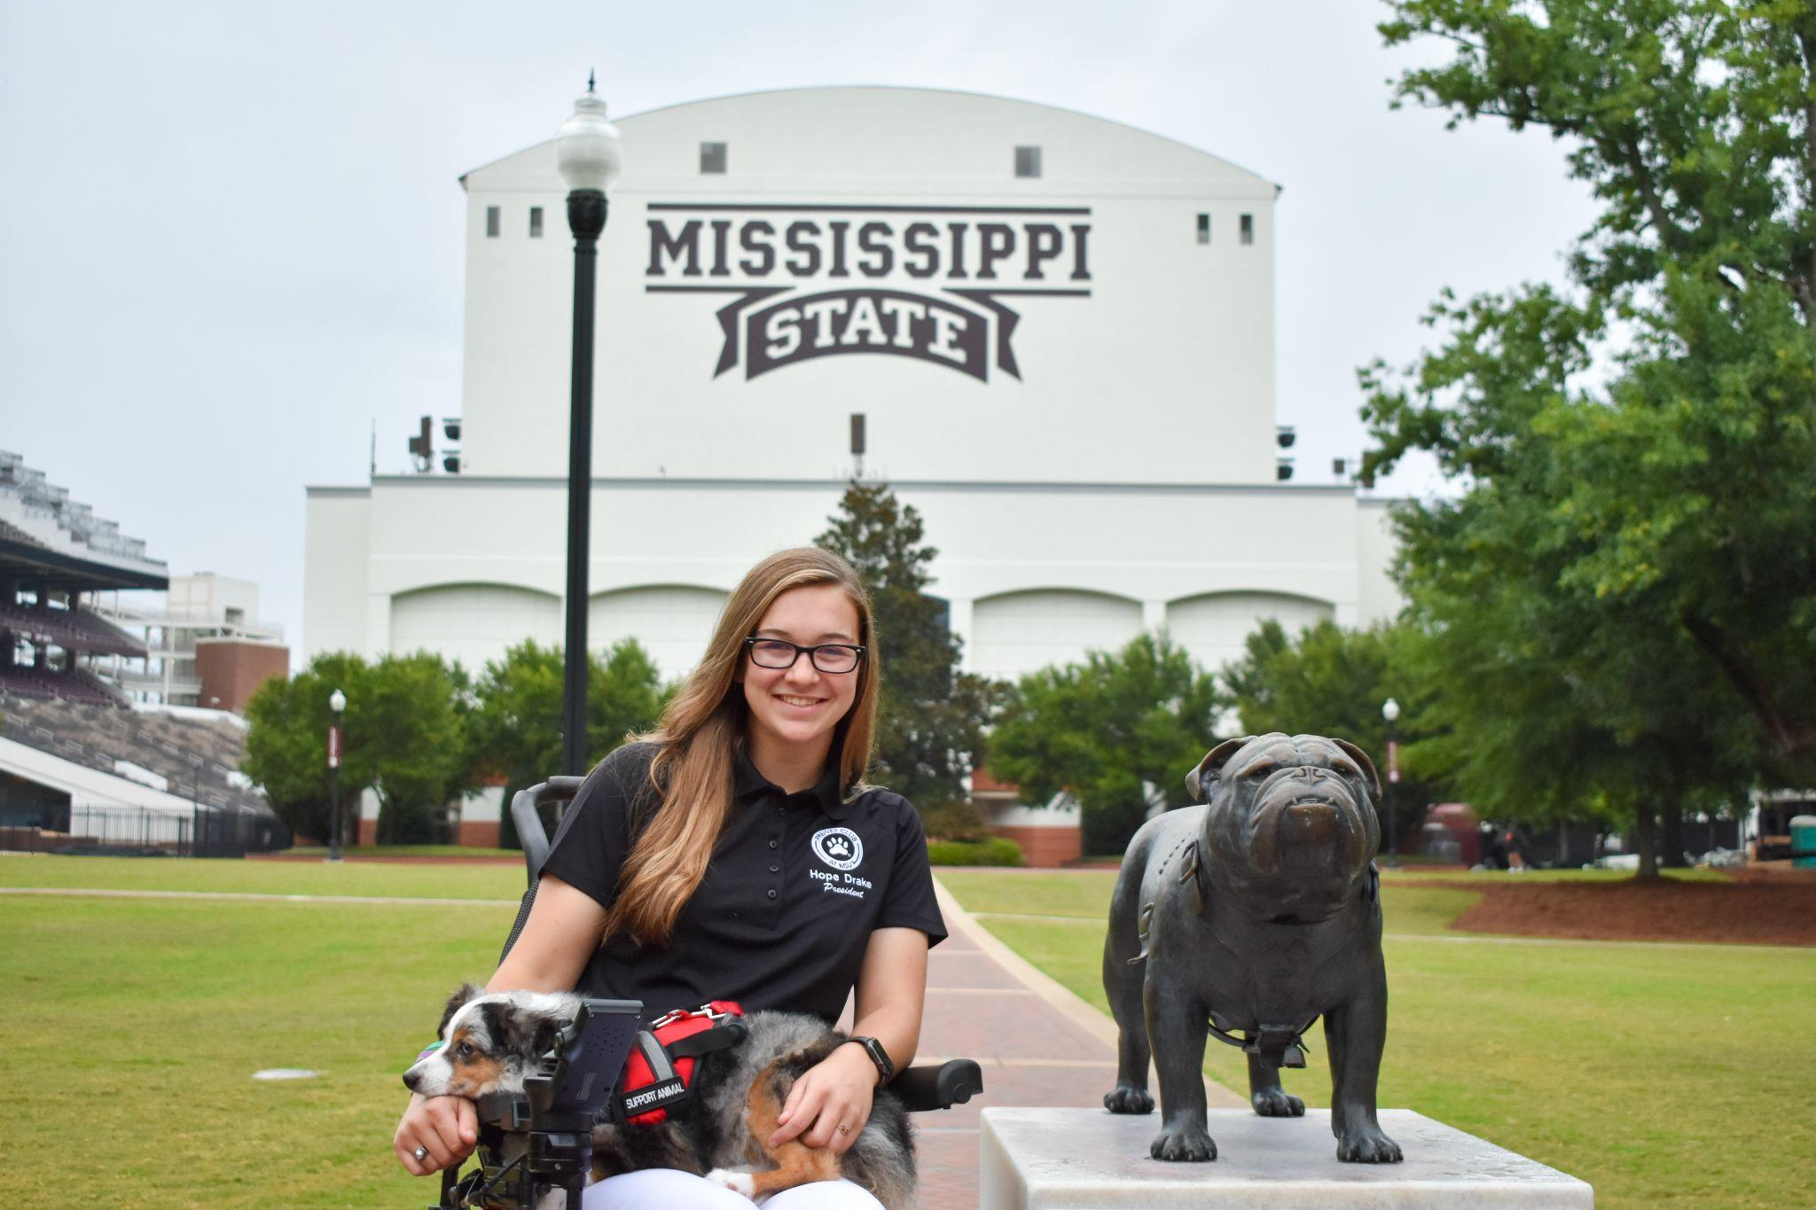
msupvcpresident@gmail.com

Slide 4
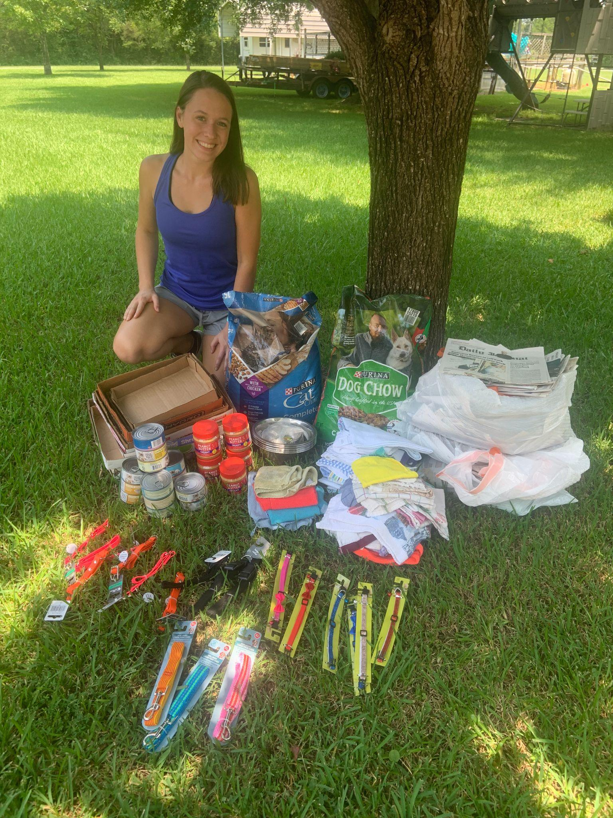
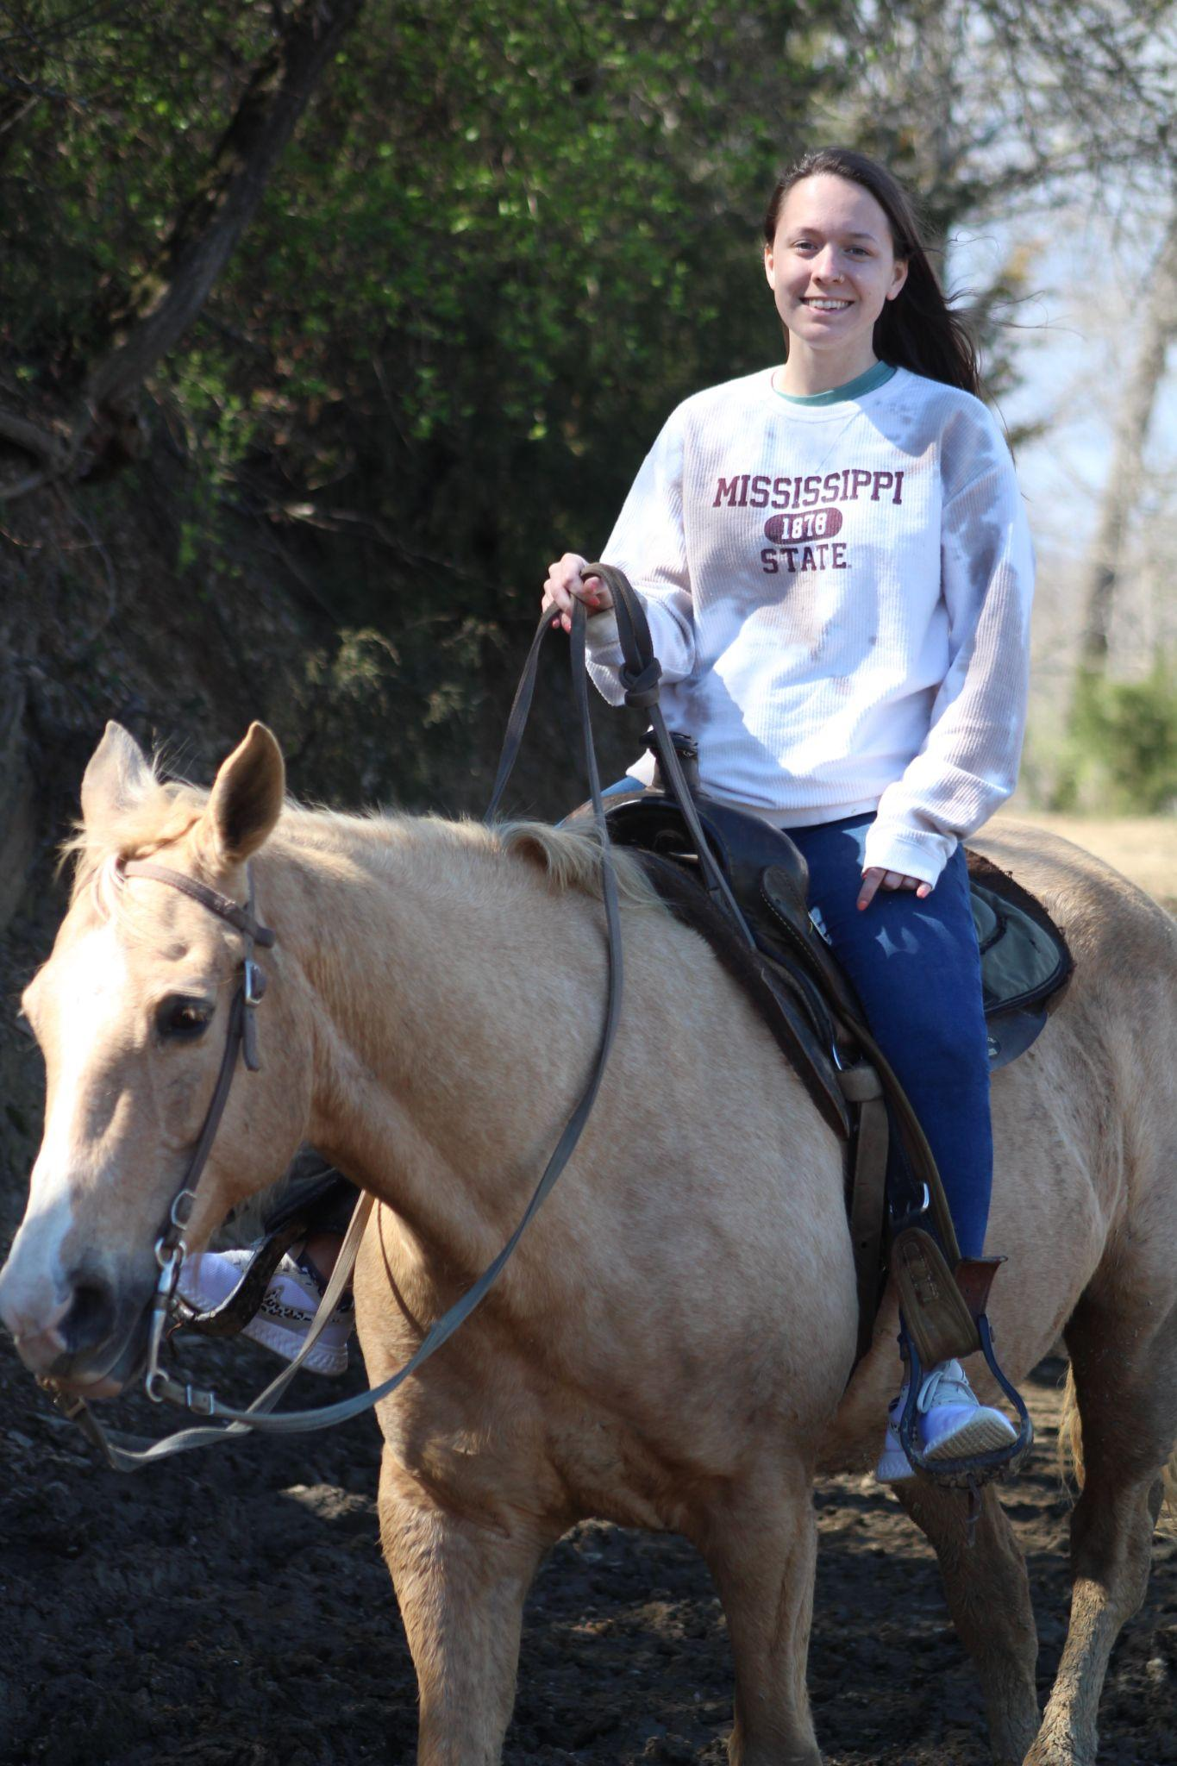
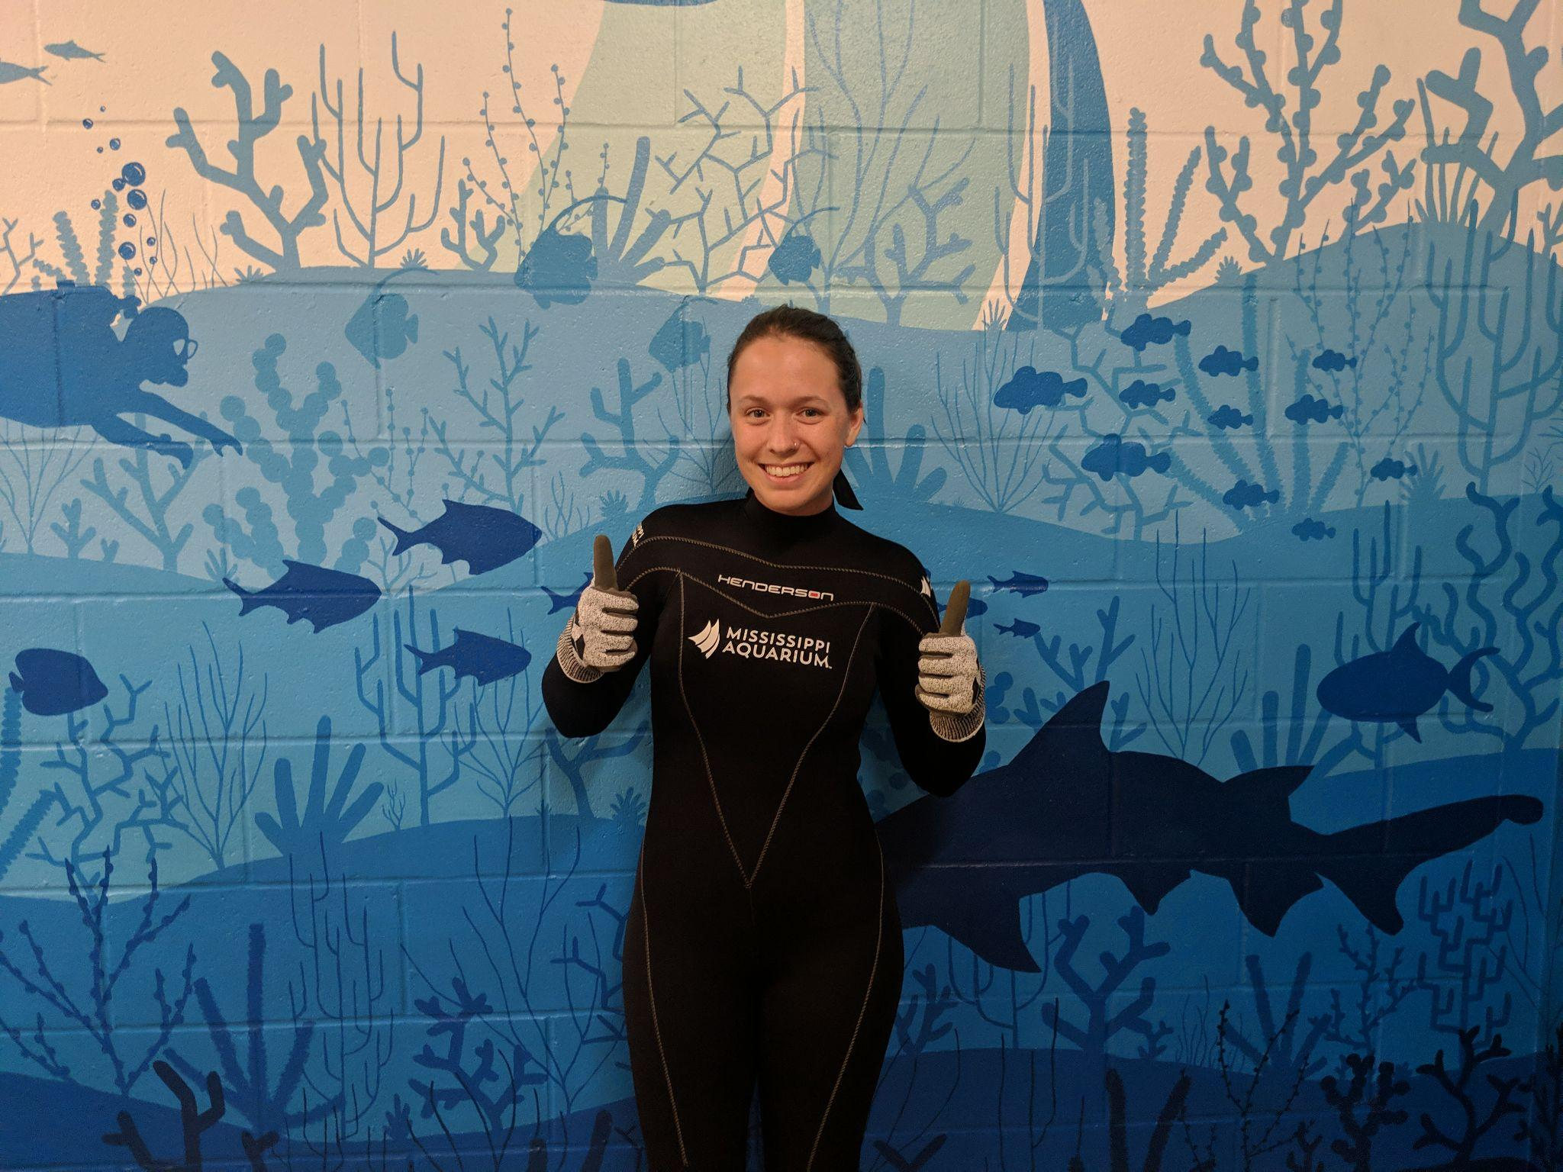
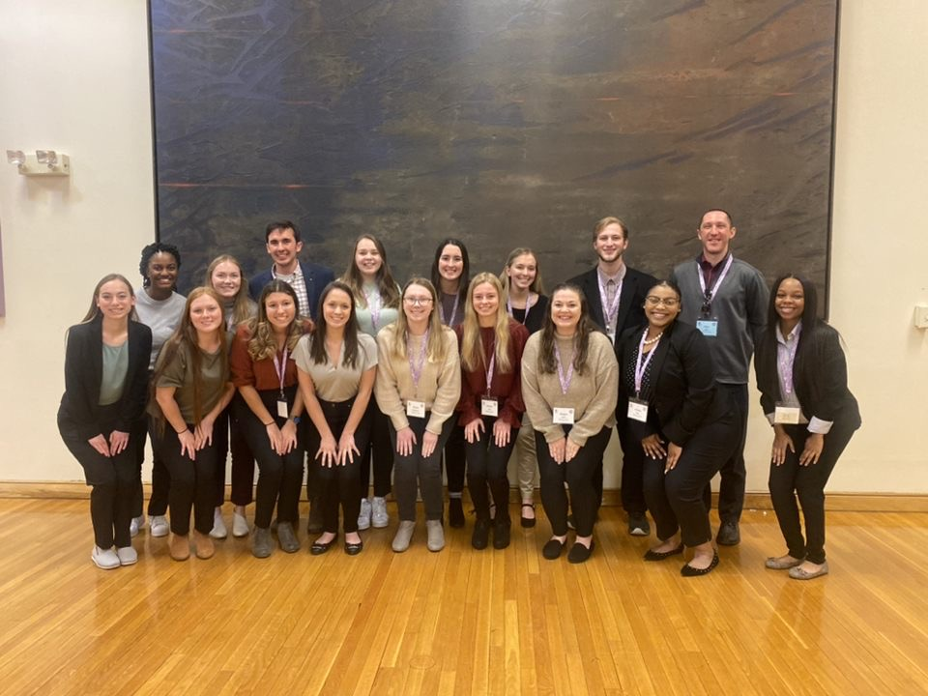
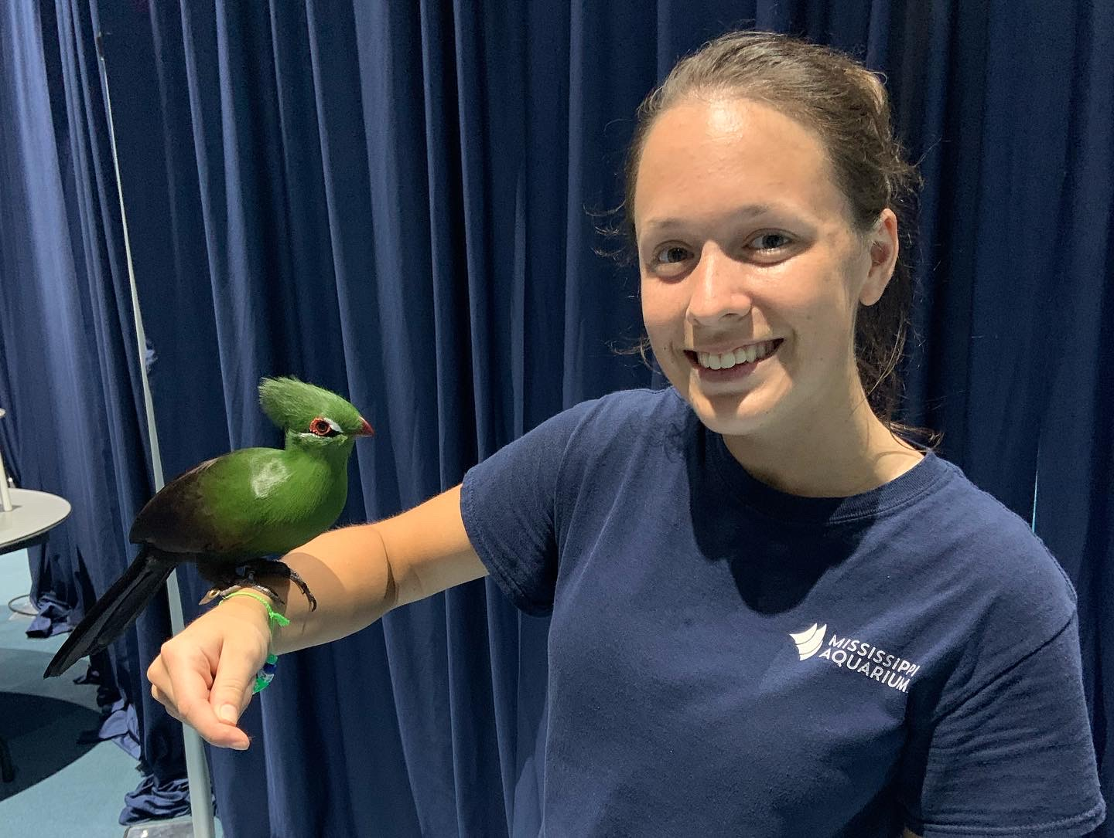
Vice President
Courtney Storey
Senior
PVC 2019

Slide 5
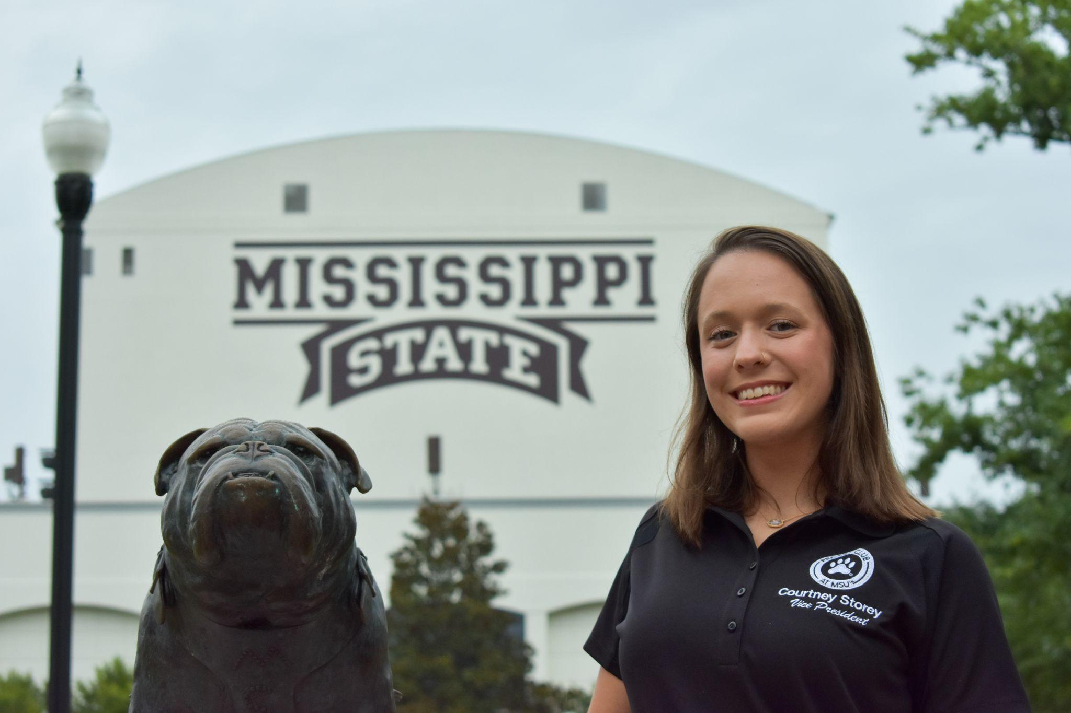
msupvcvicepresident@gmail.com

Slide 6
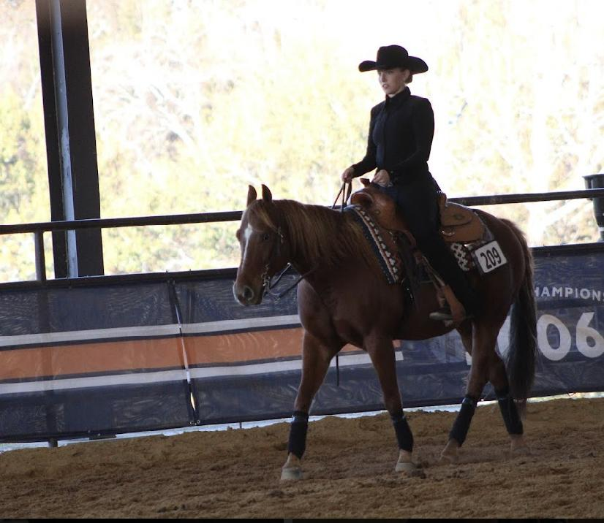
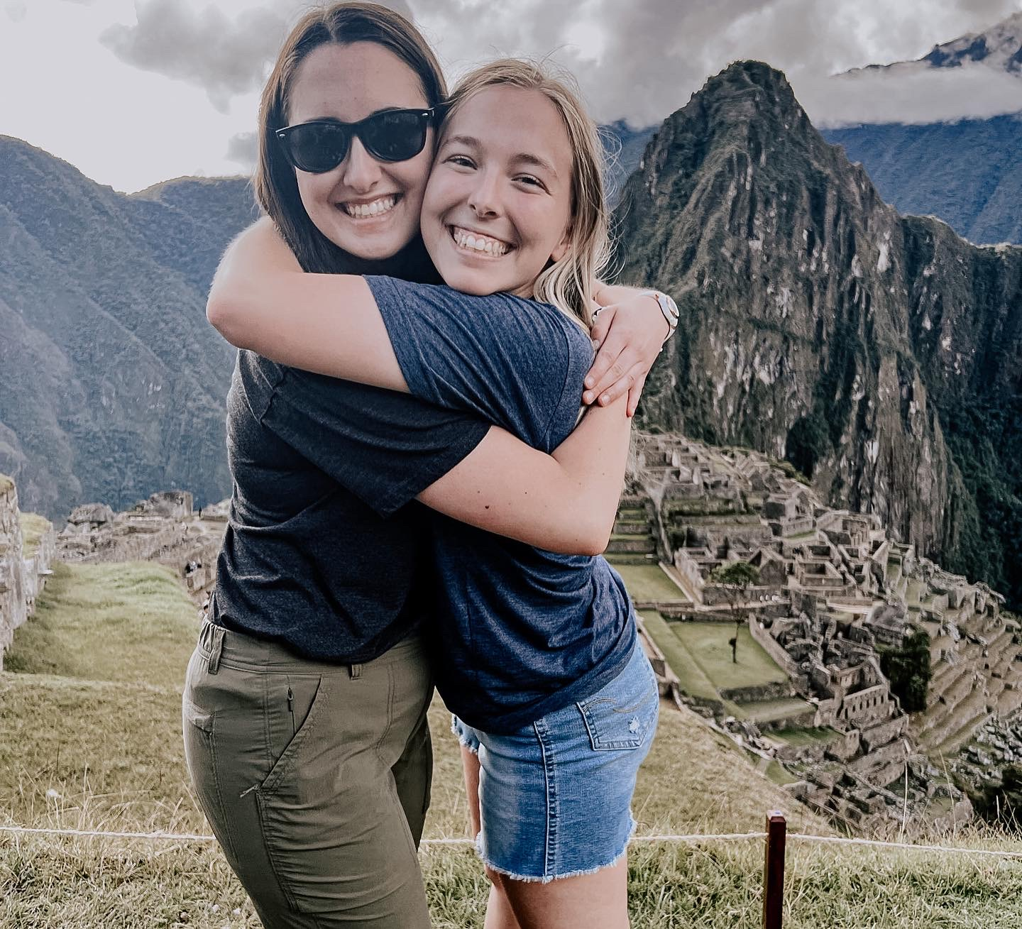
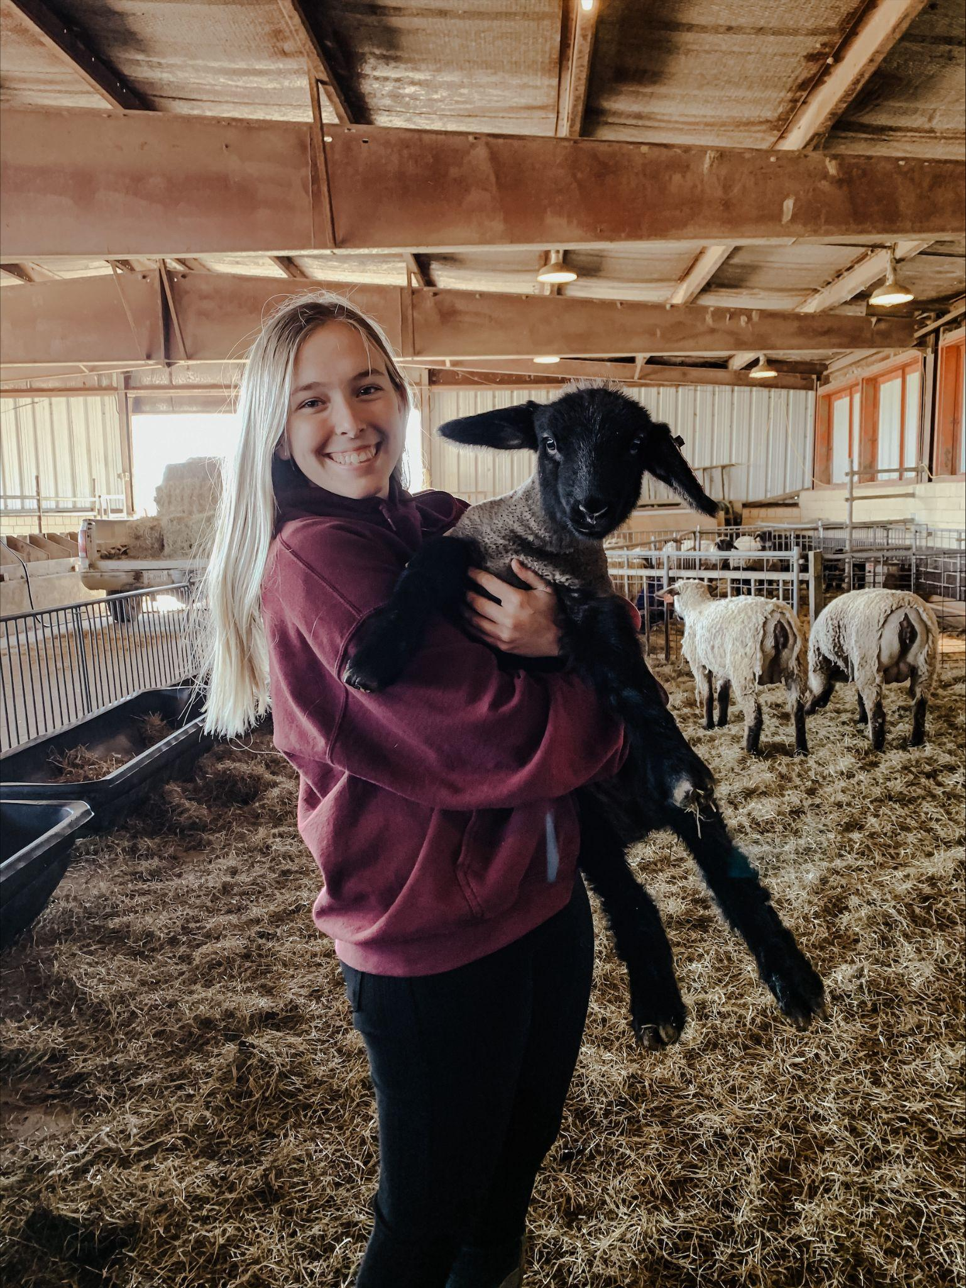
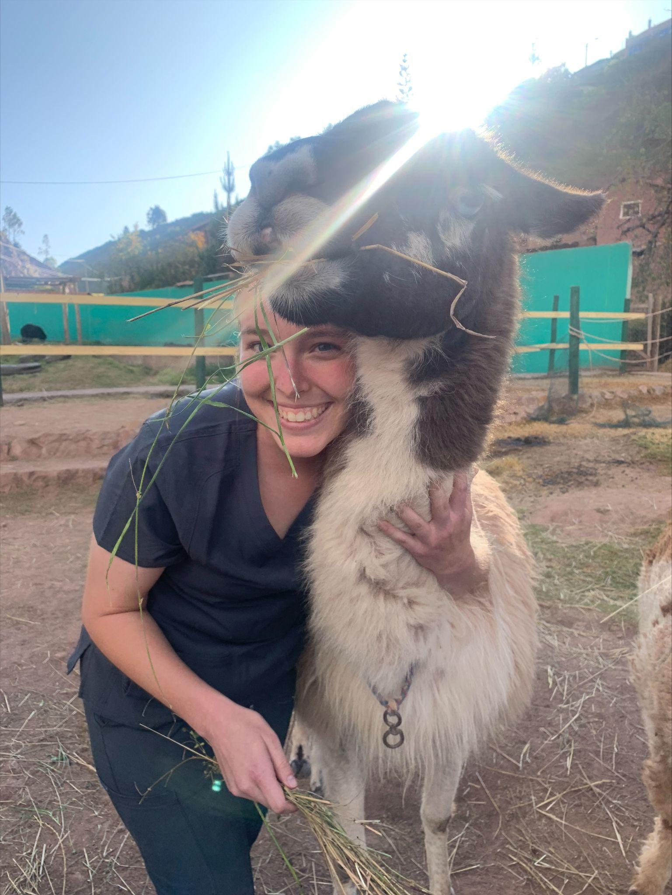
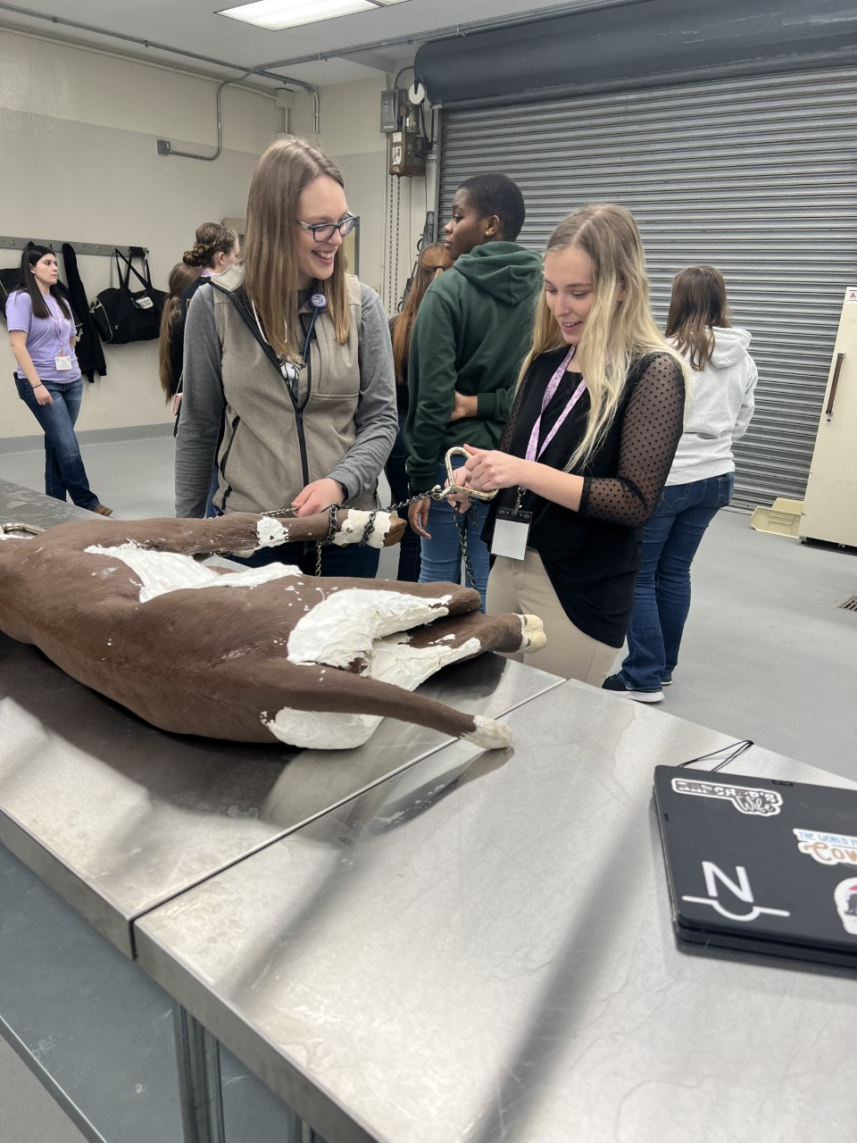
Secretary
Hannah Brasher
Junior
PVC 2020

Slide 7
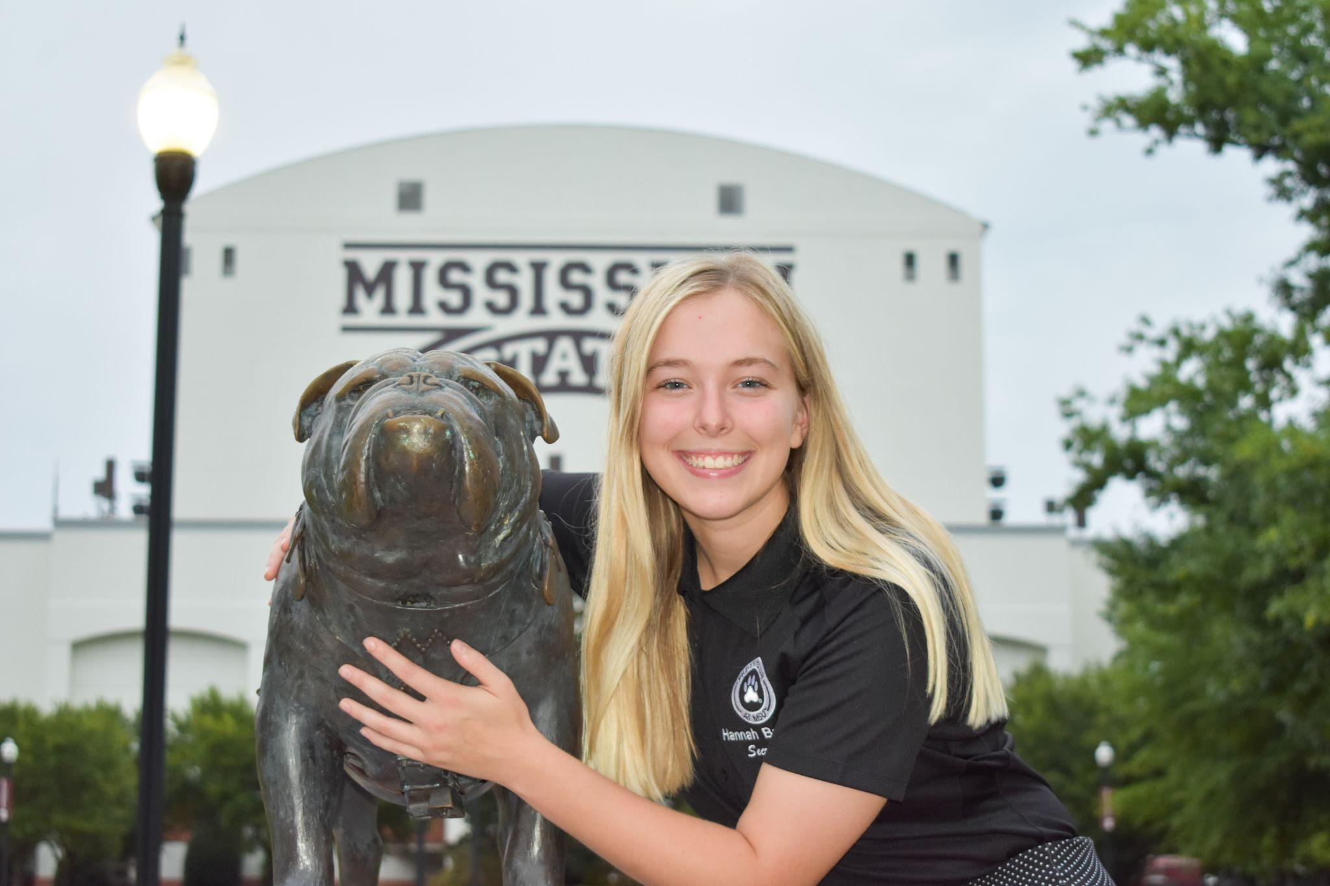
msupvcsecretary@gmail.com

Slide 8
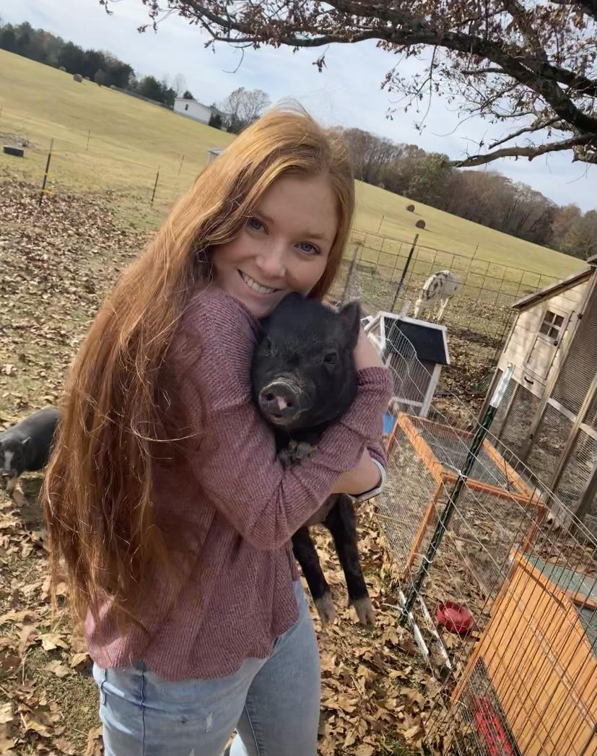
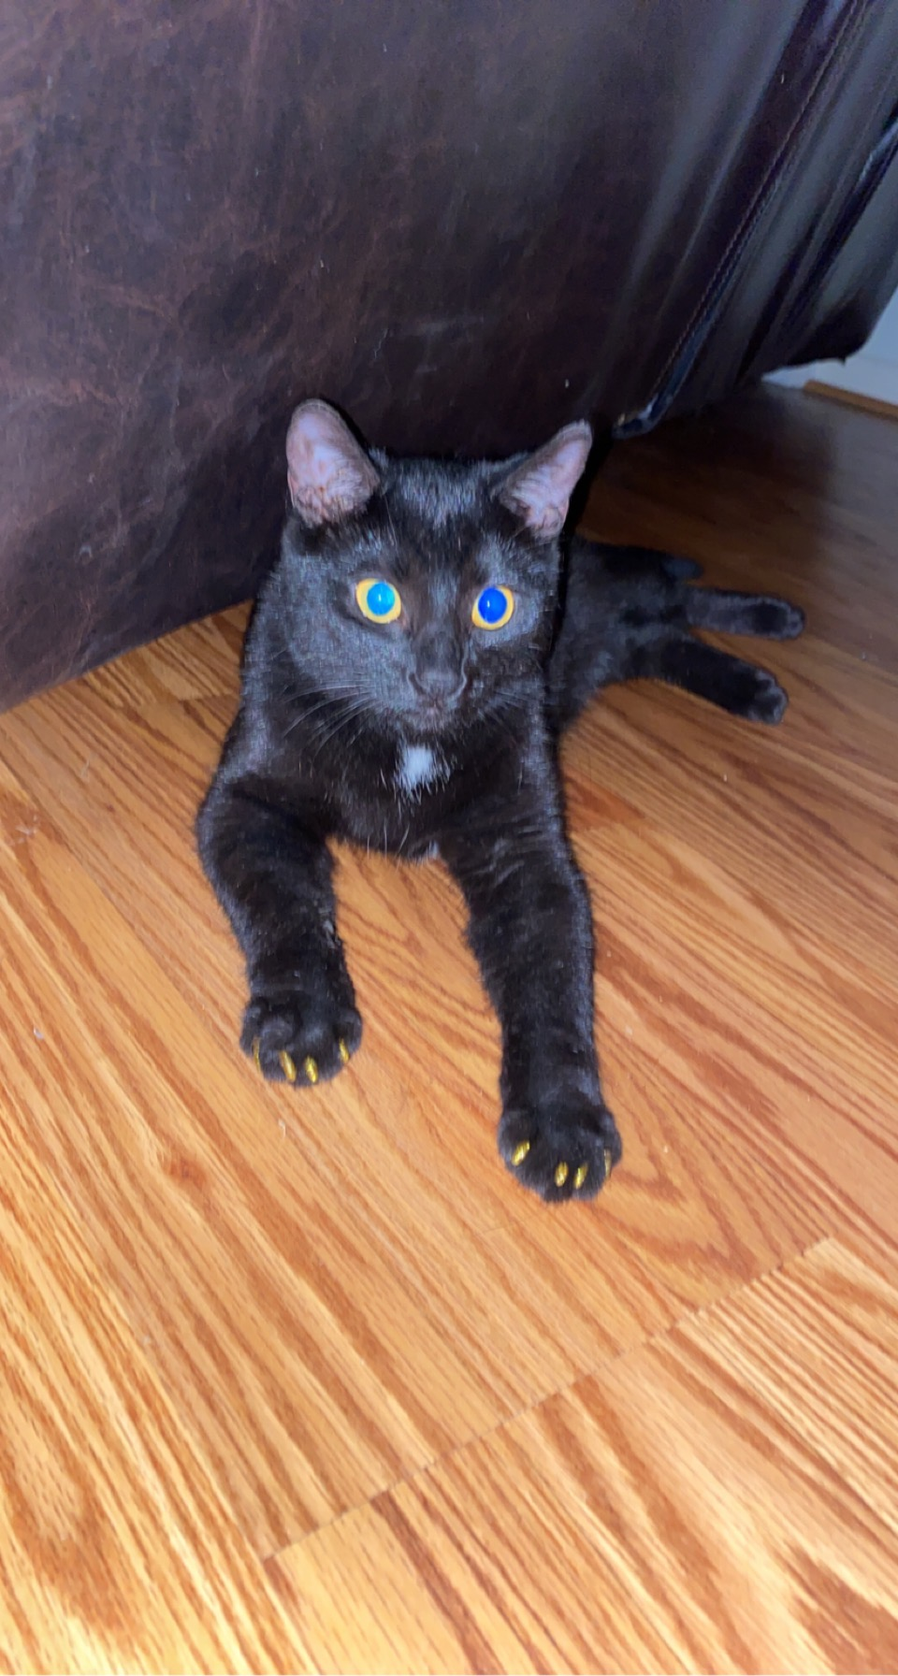
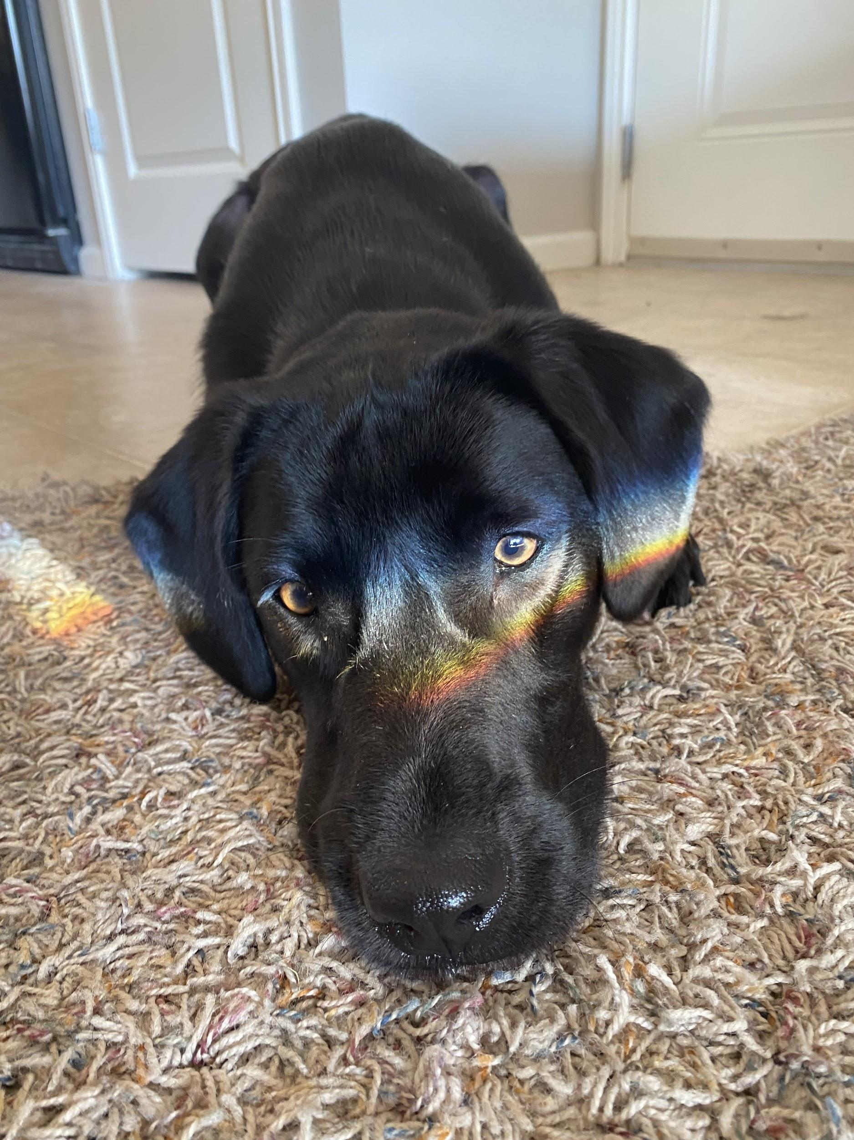
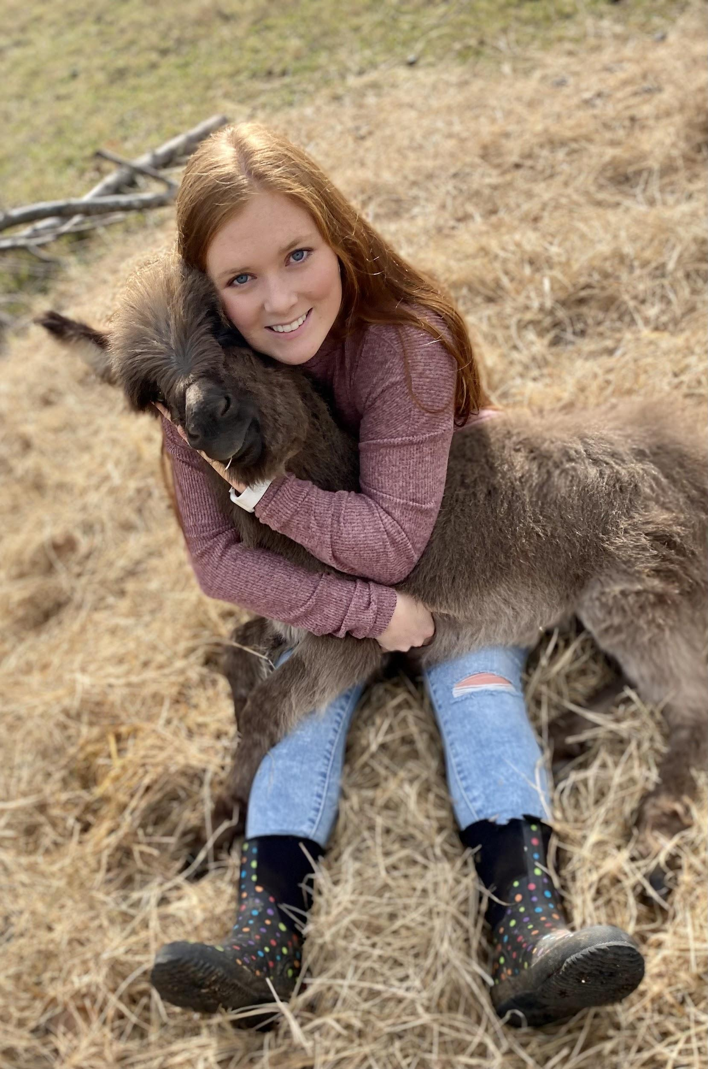
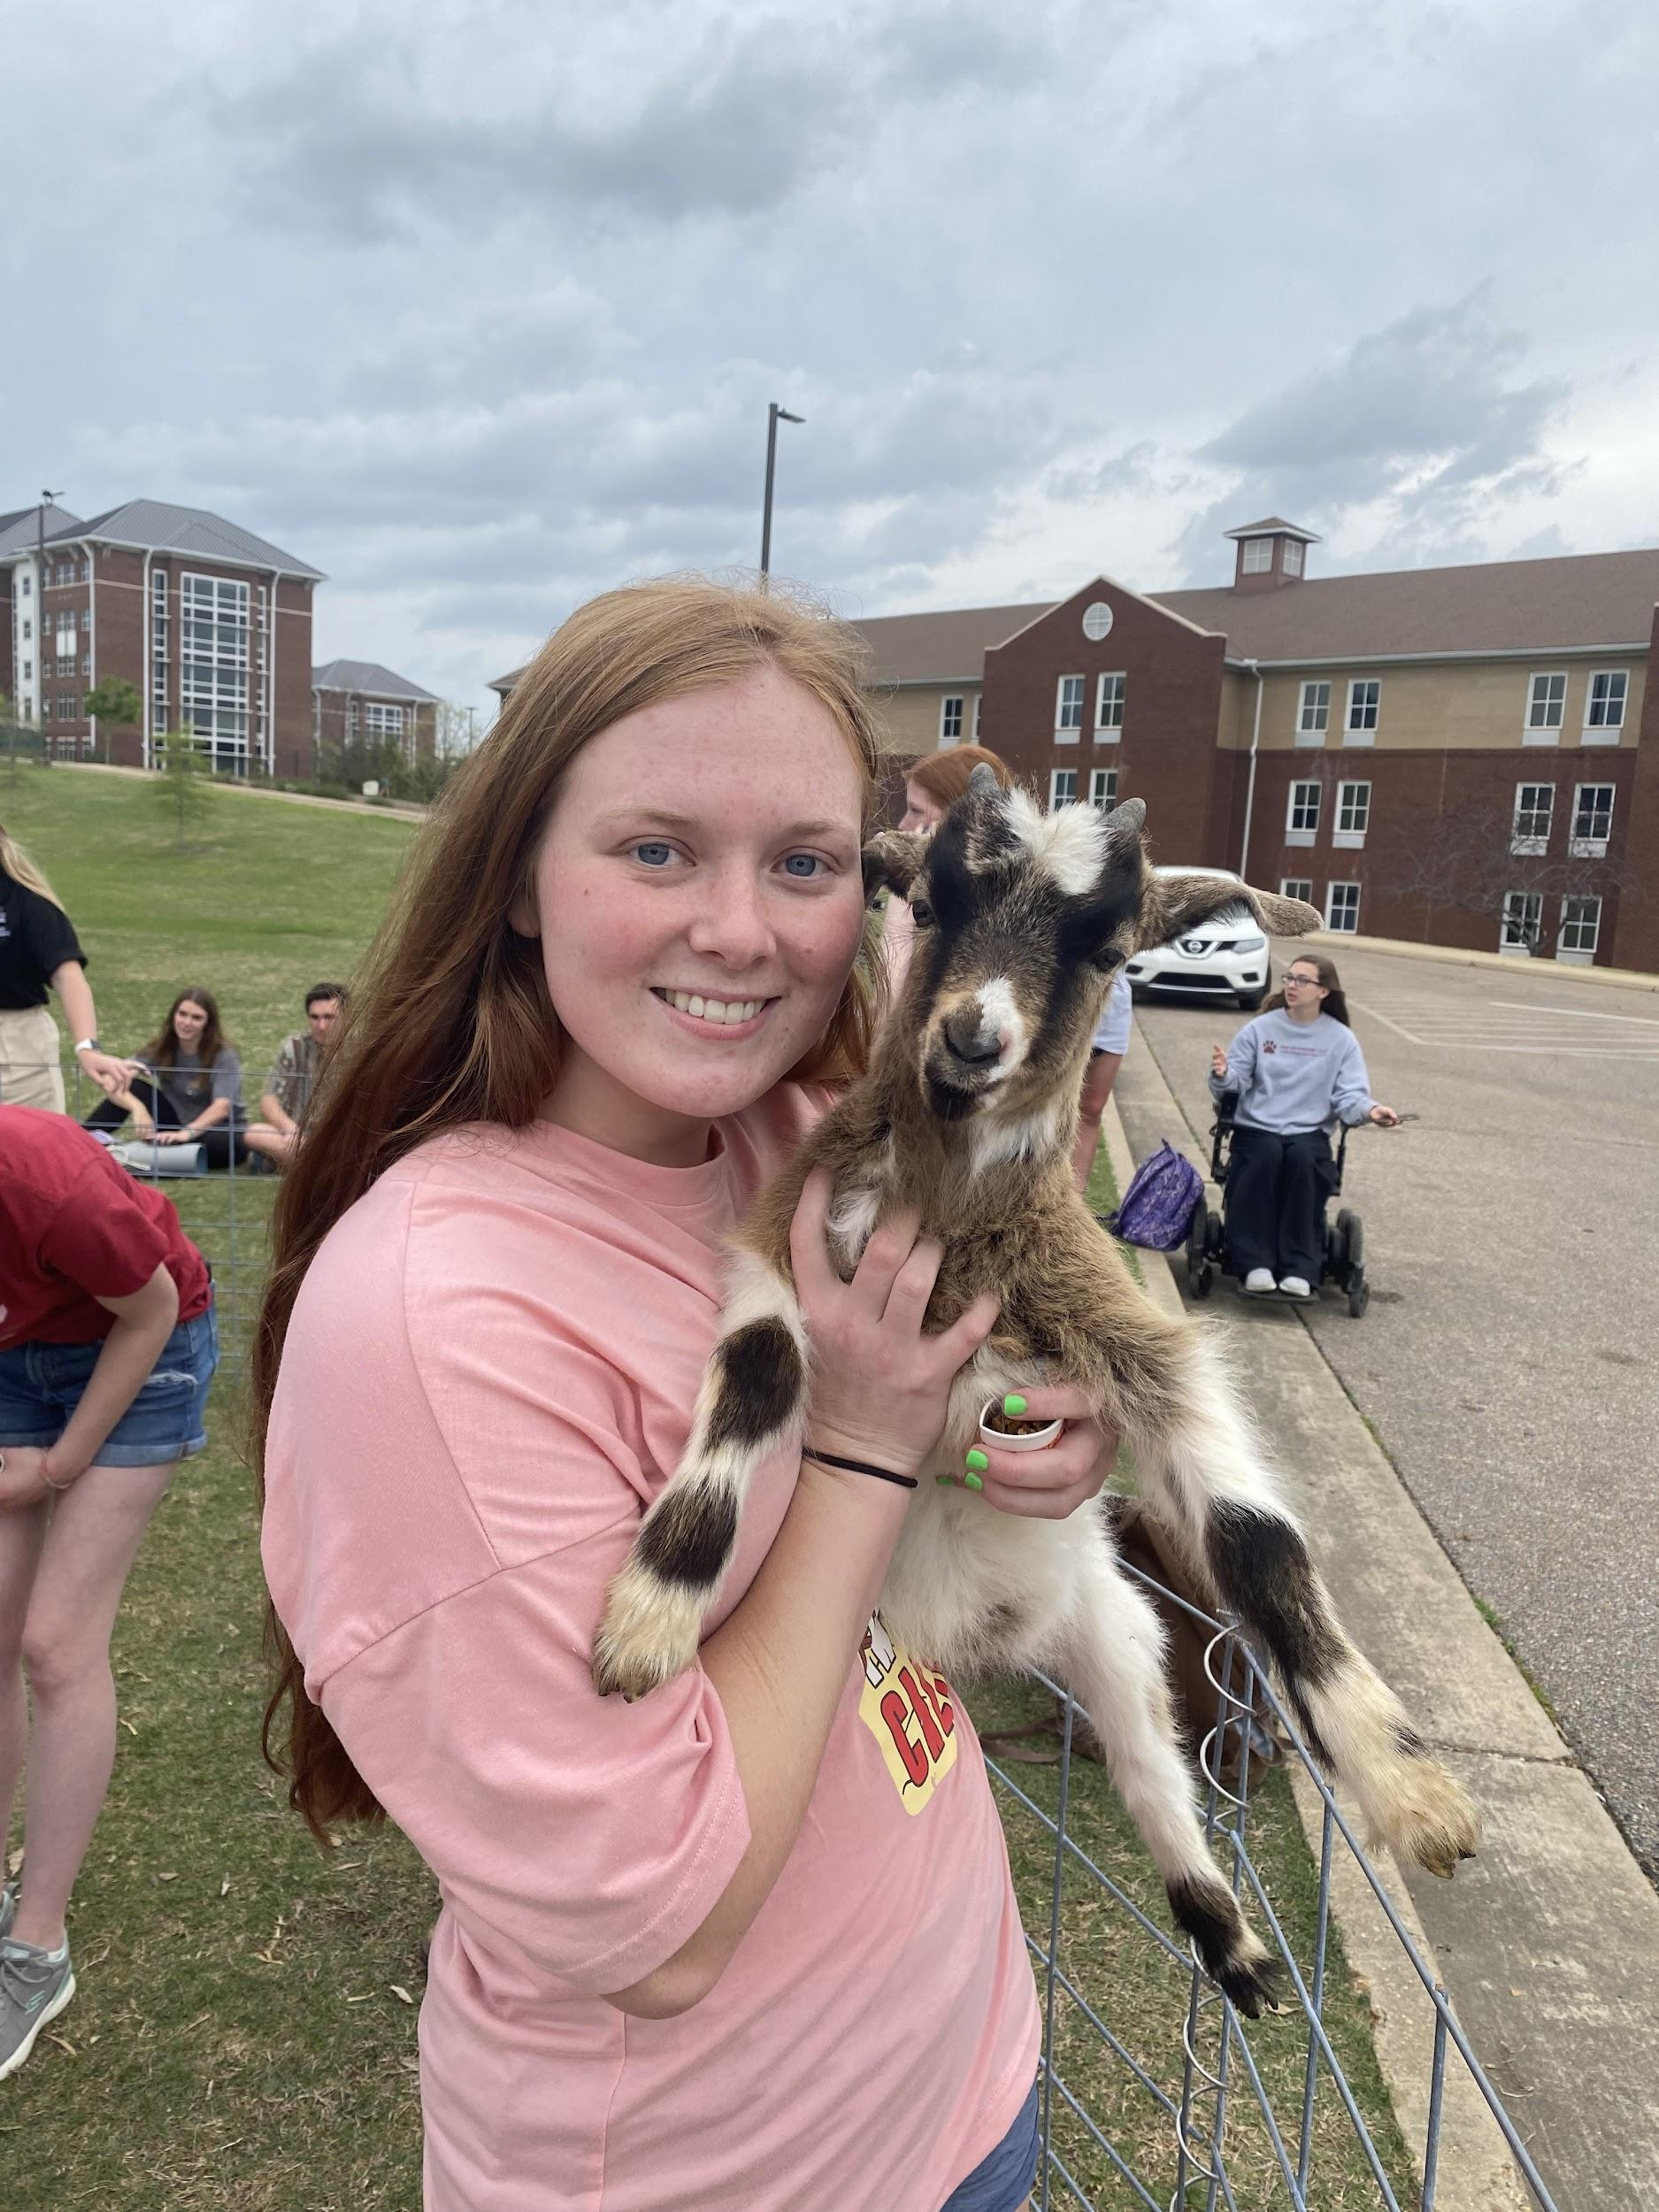
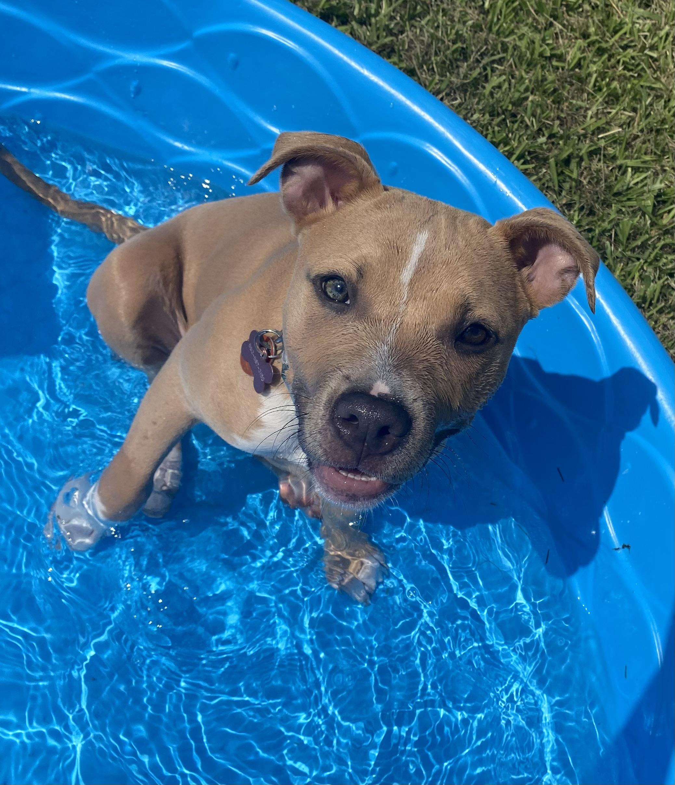
Treasurer
Zeta Mooney

Slide 9
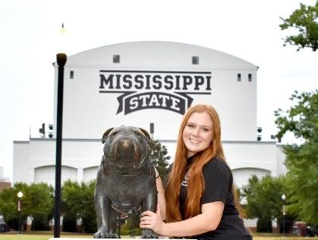
msupvctreasurer@gmail.com

Slide 10



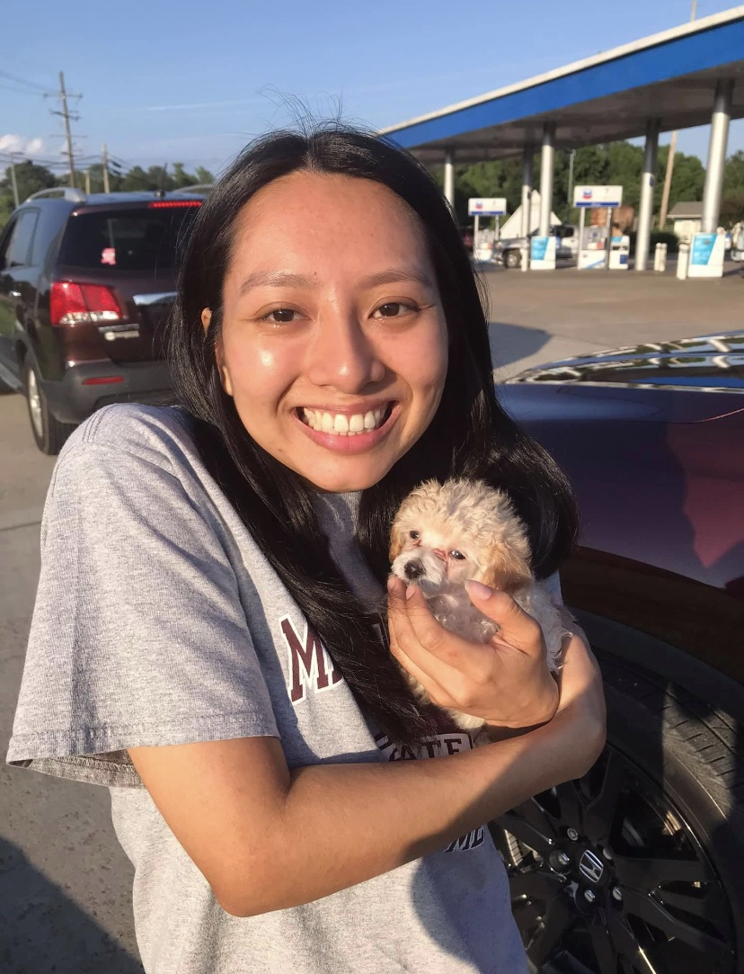
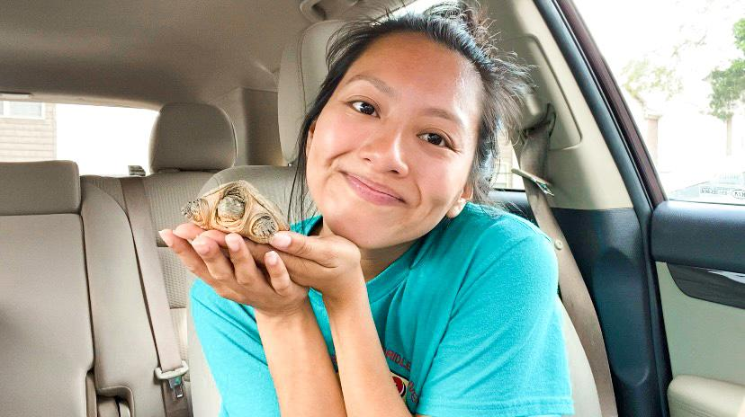
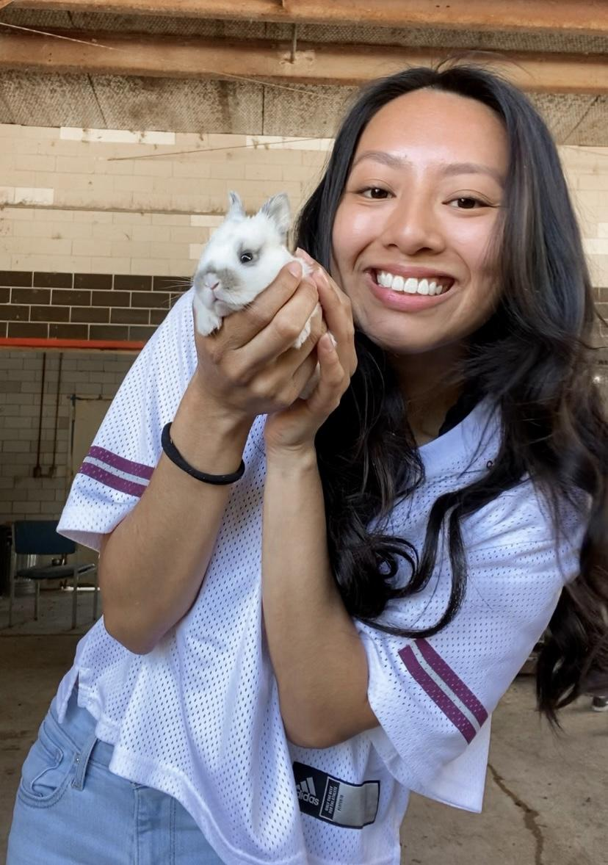

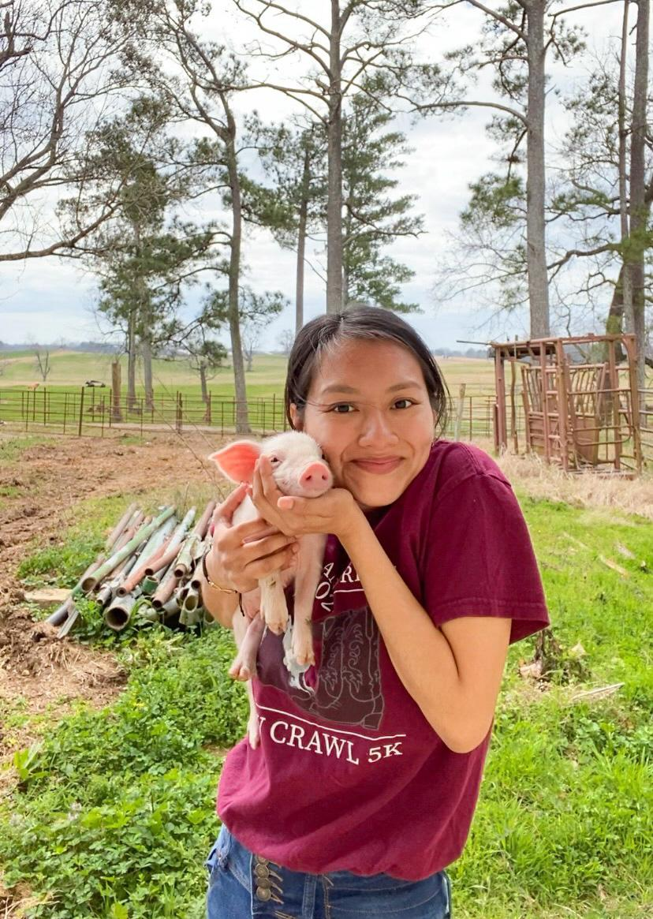
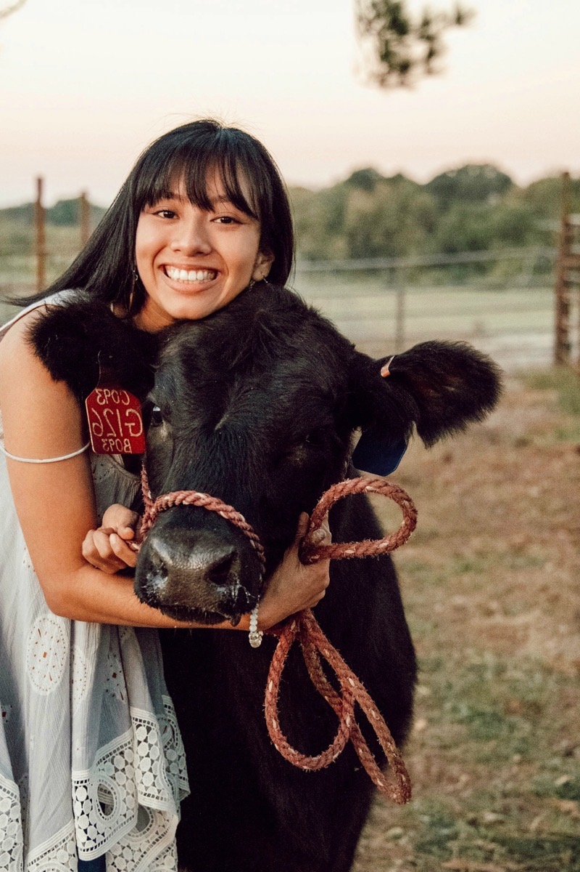


Public Relations
Andrea Gonzalez Lopez

Slide 11
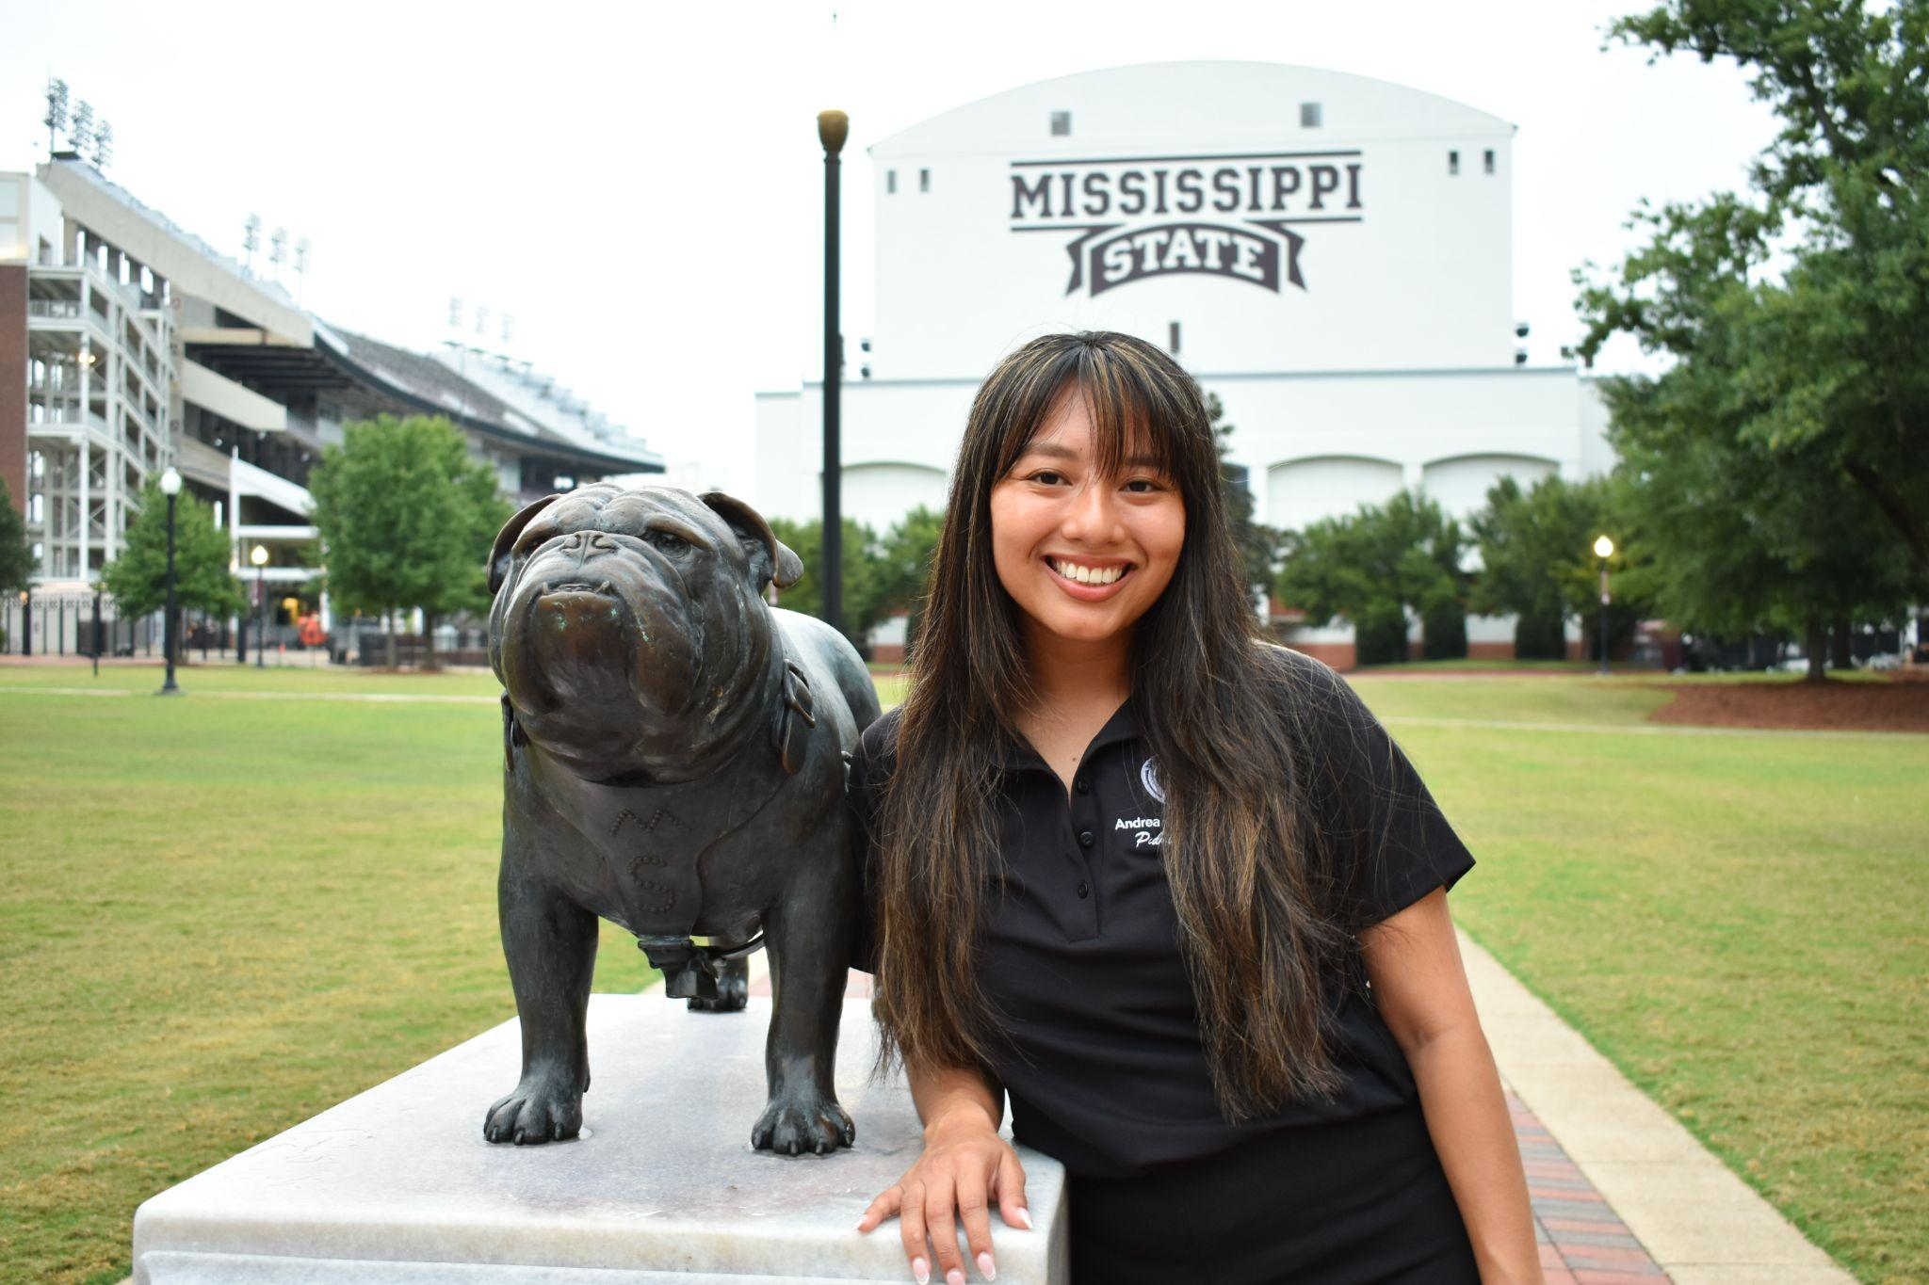
msupvcpublicrelations@gmail.com

Slide 12
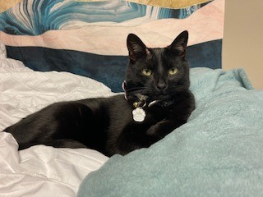
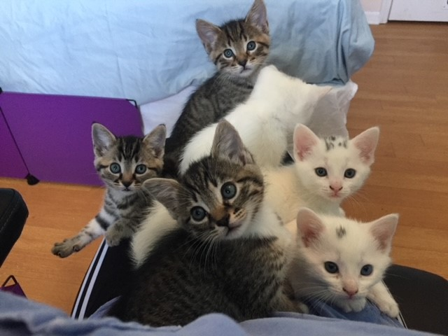
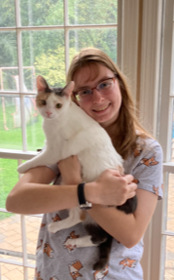
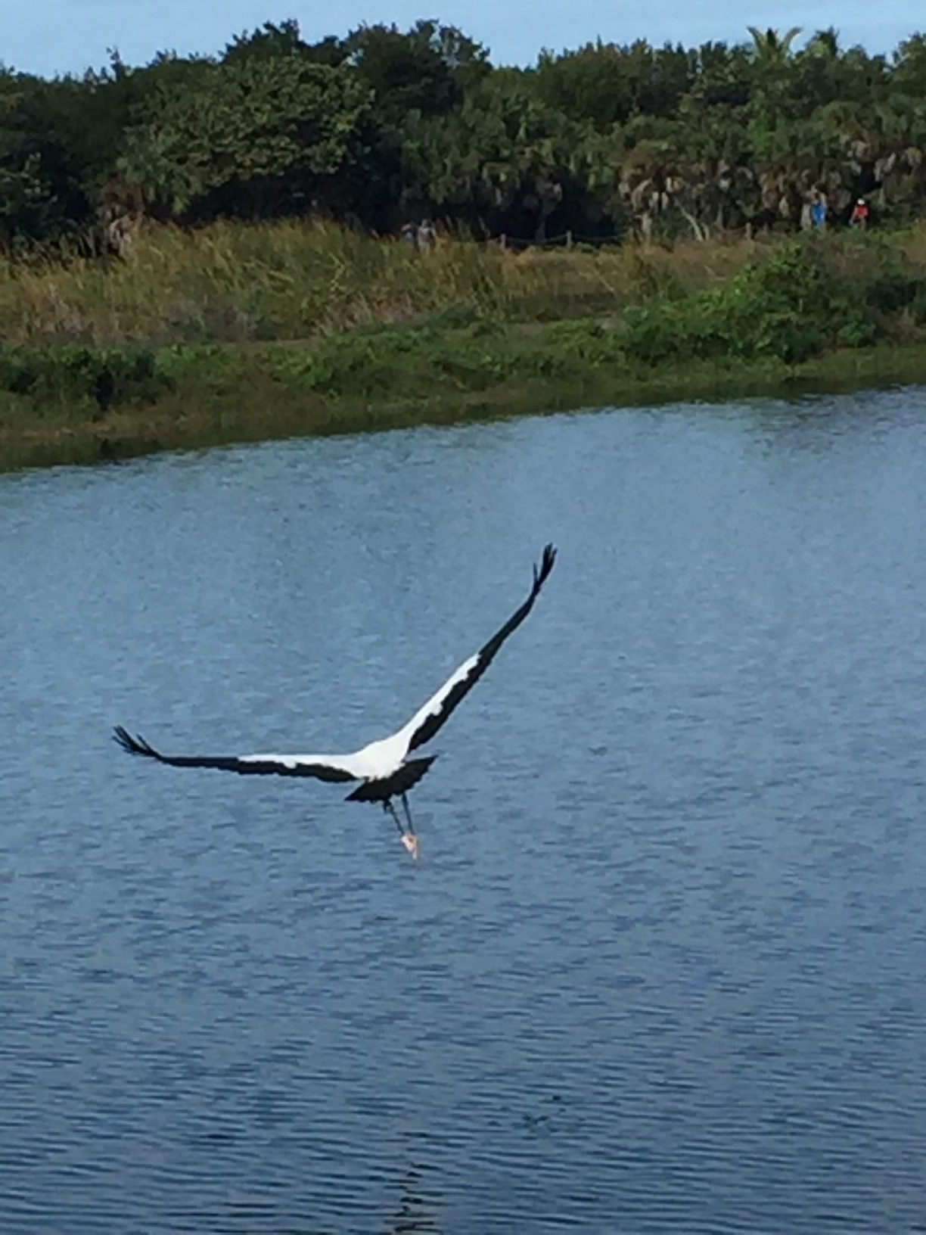
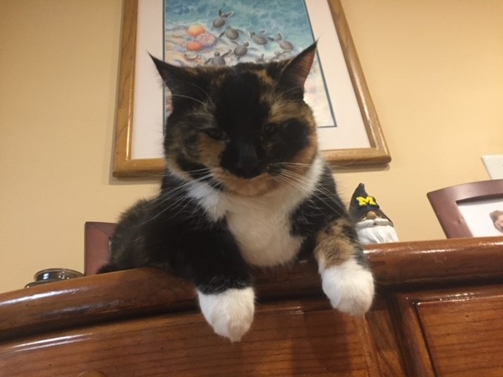
Social Chair
Jessica Moroso

Slide 13
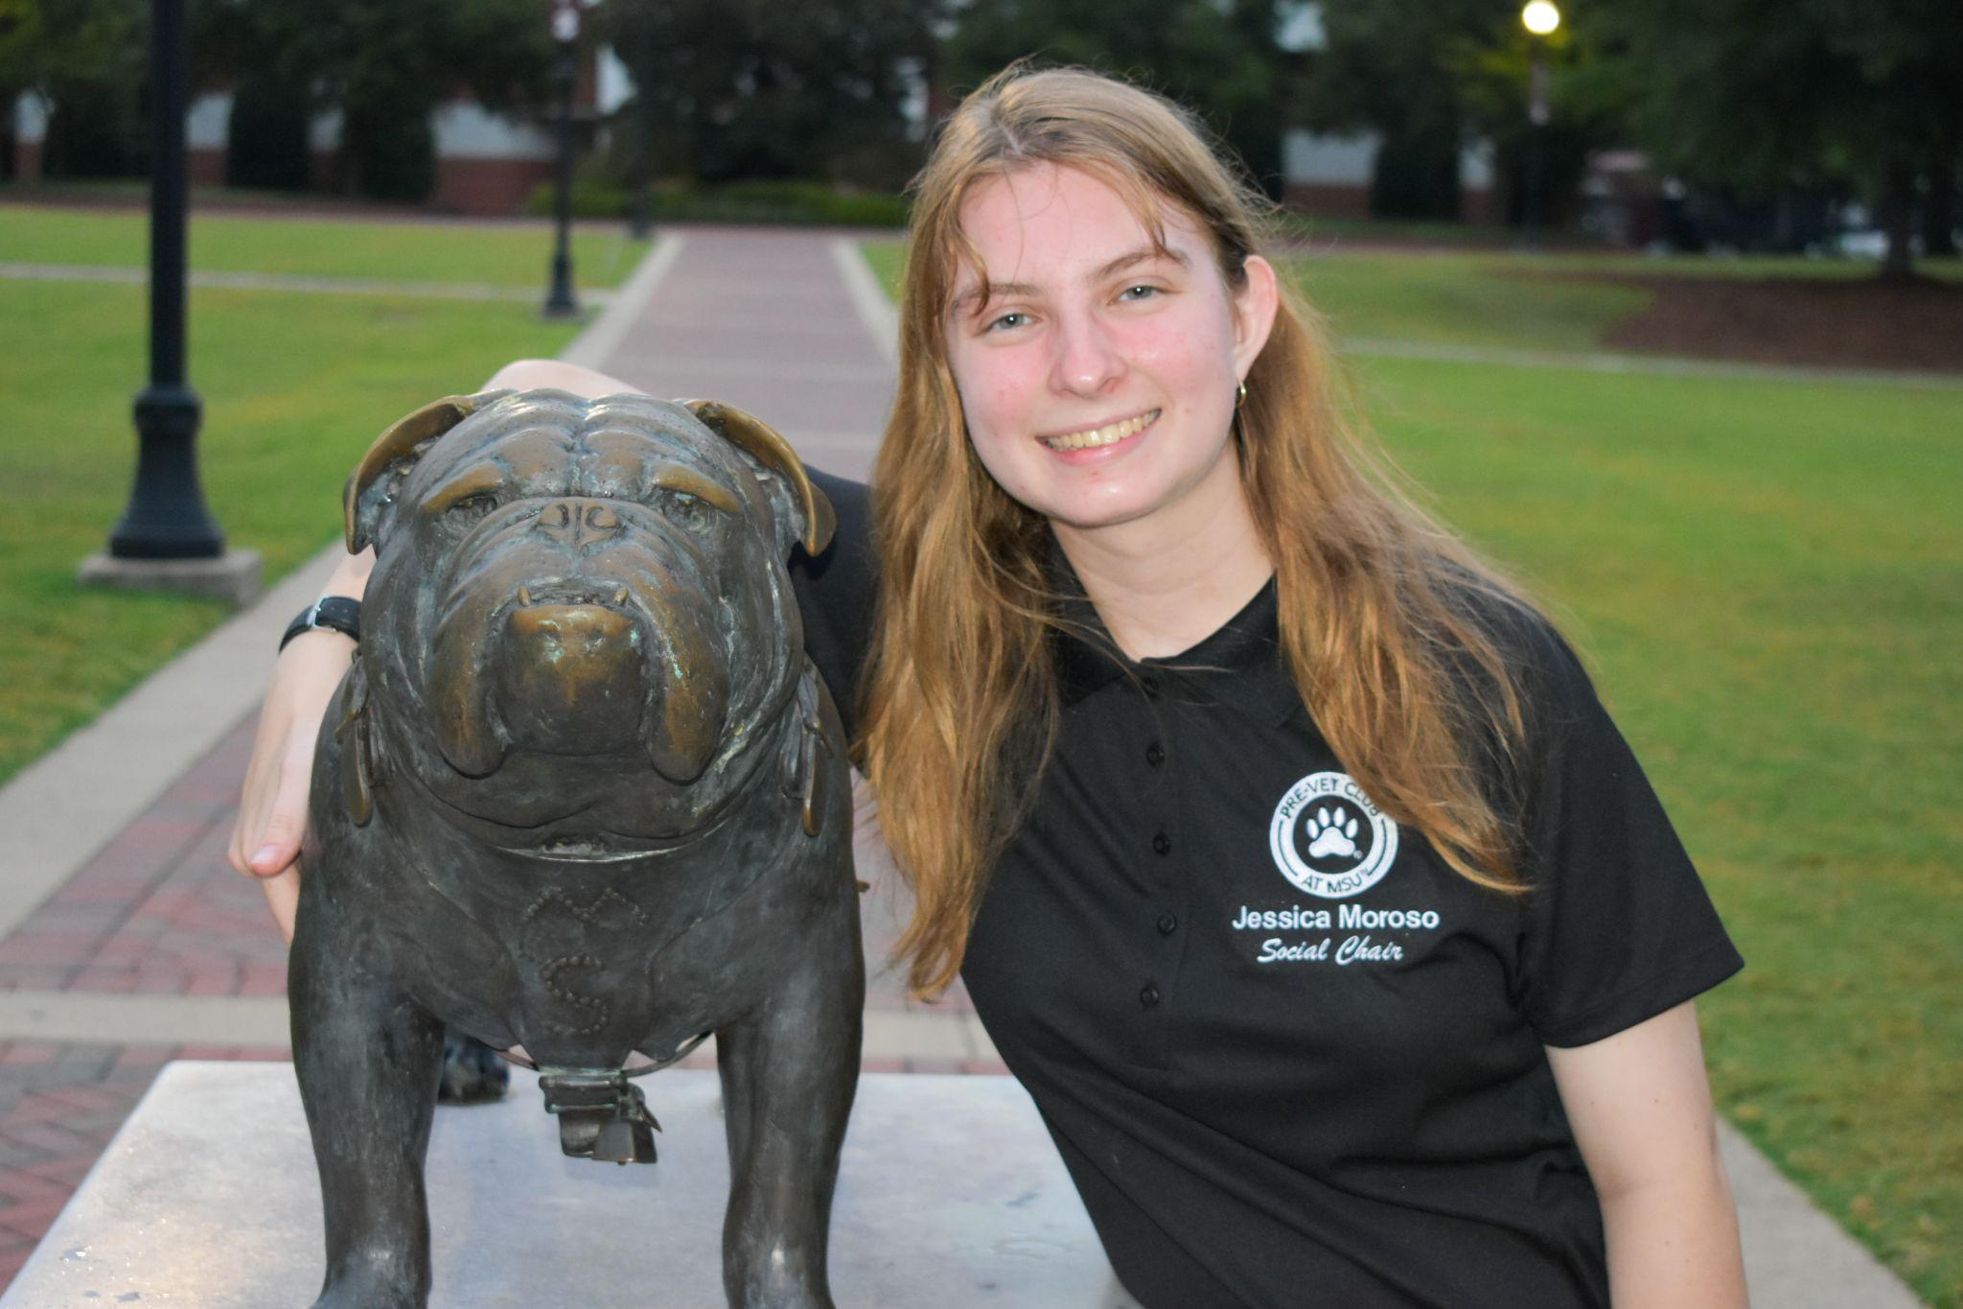
msupvcsocialchair@gmail.com

Slide 14


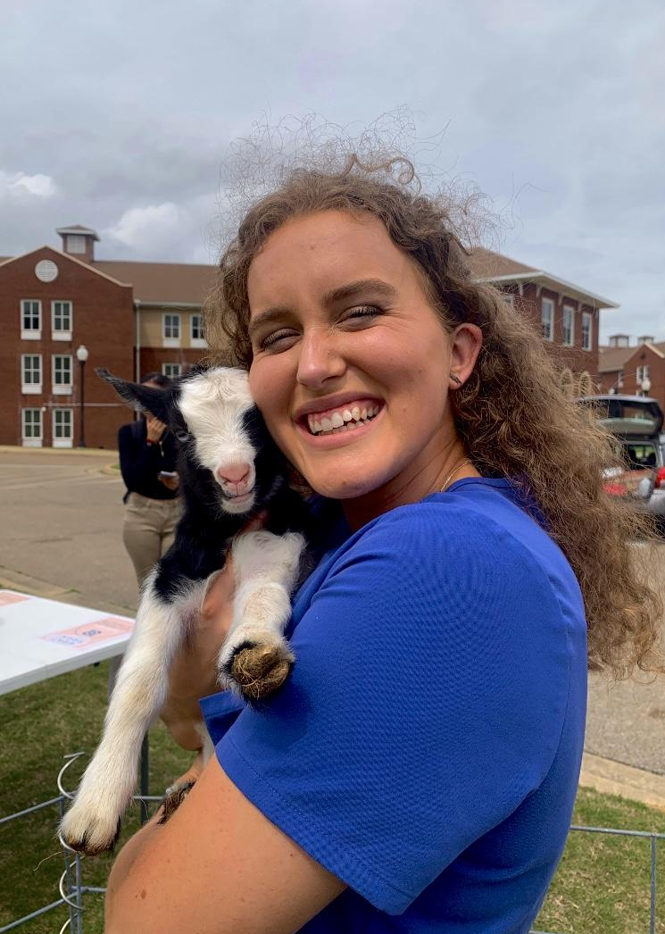

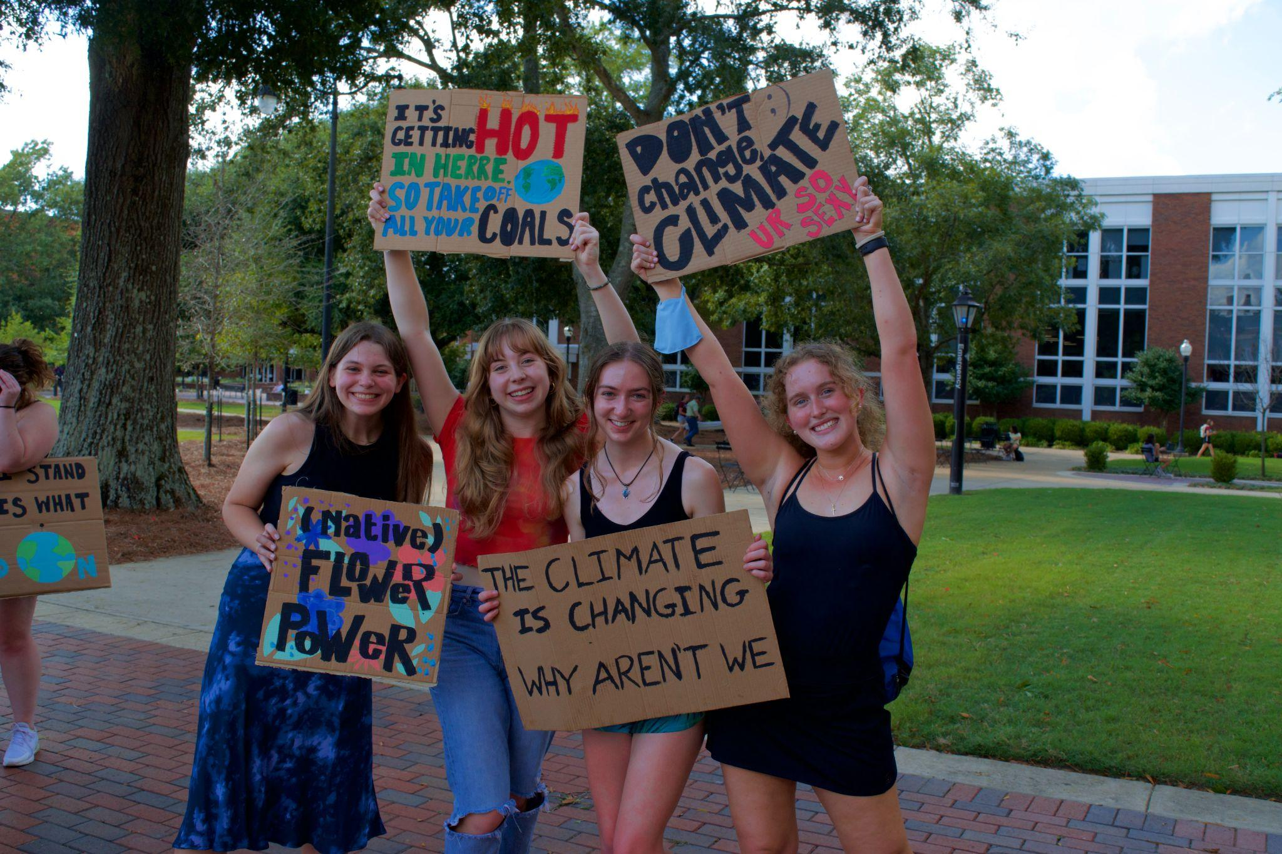
Webmaster
Madelyn Hunter

Slide 15
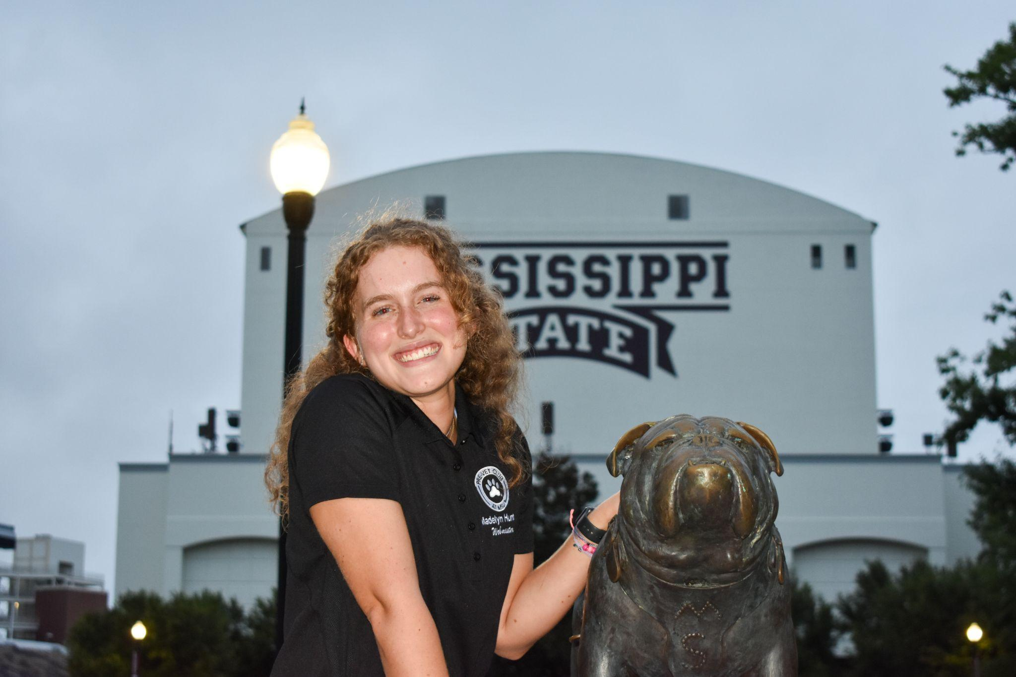
msupvcwebmaster@gmail.com

Slide 16
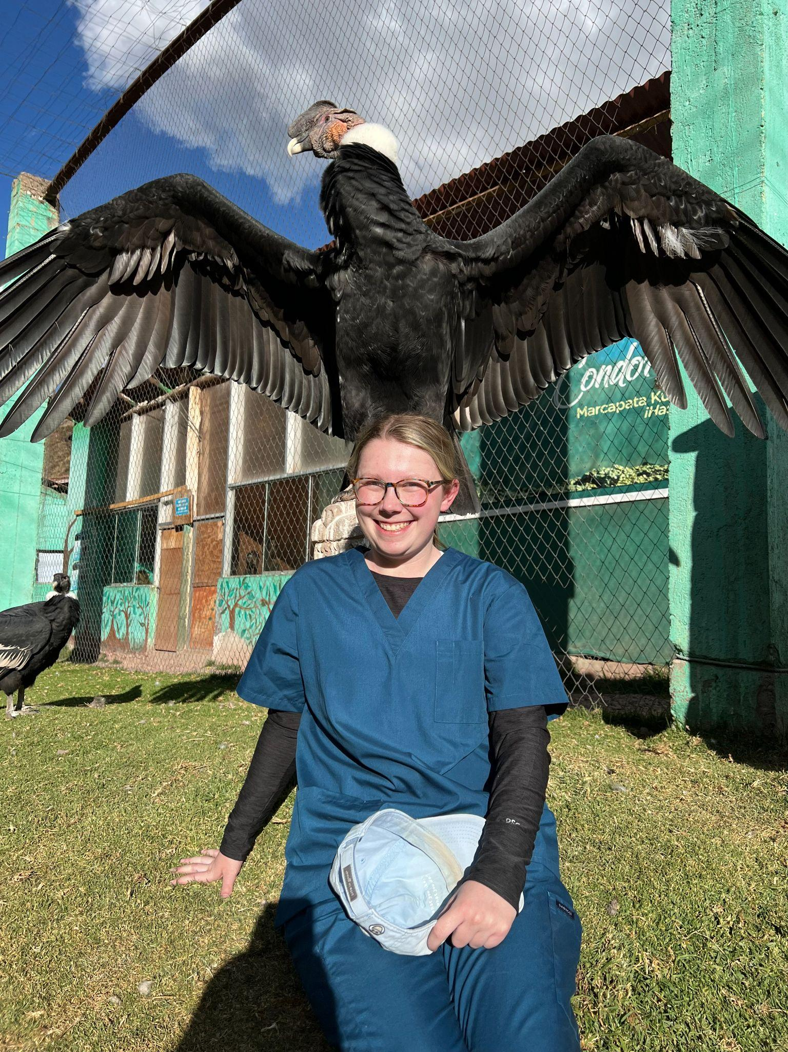
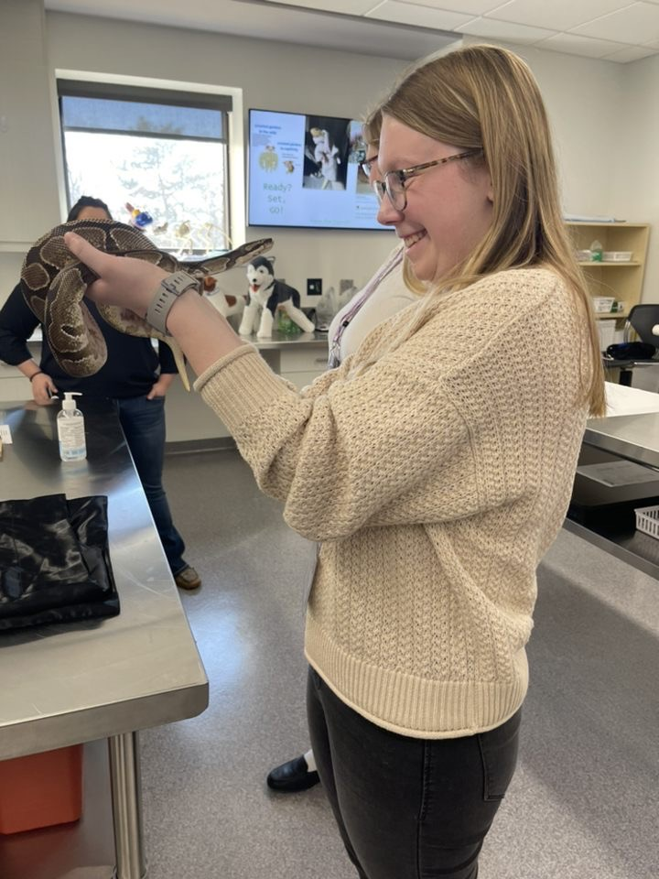
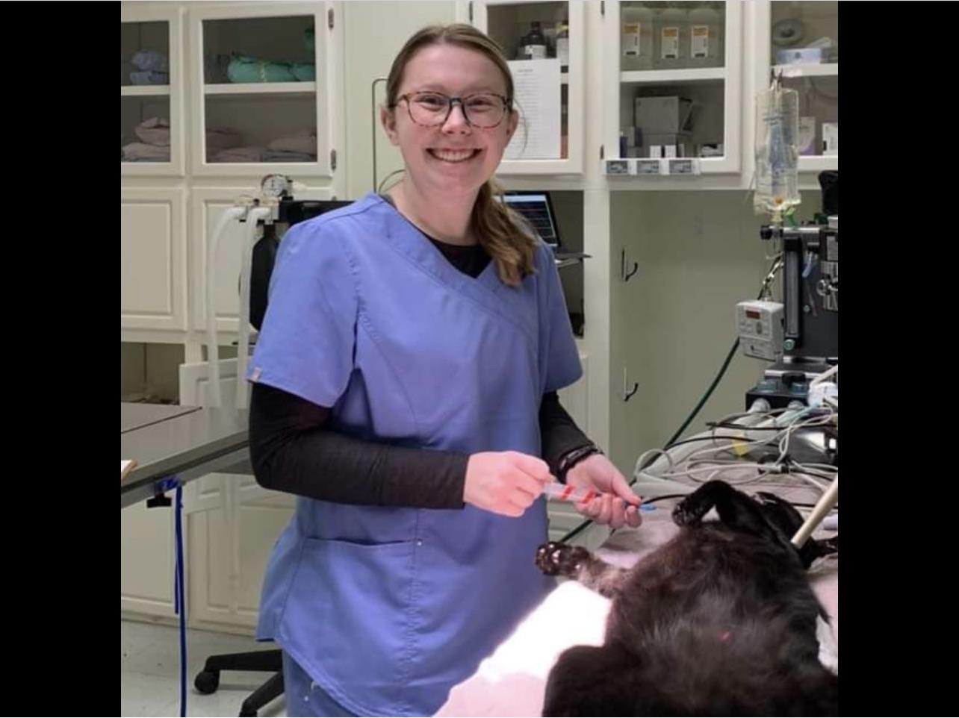
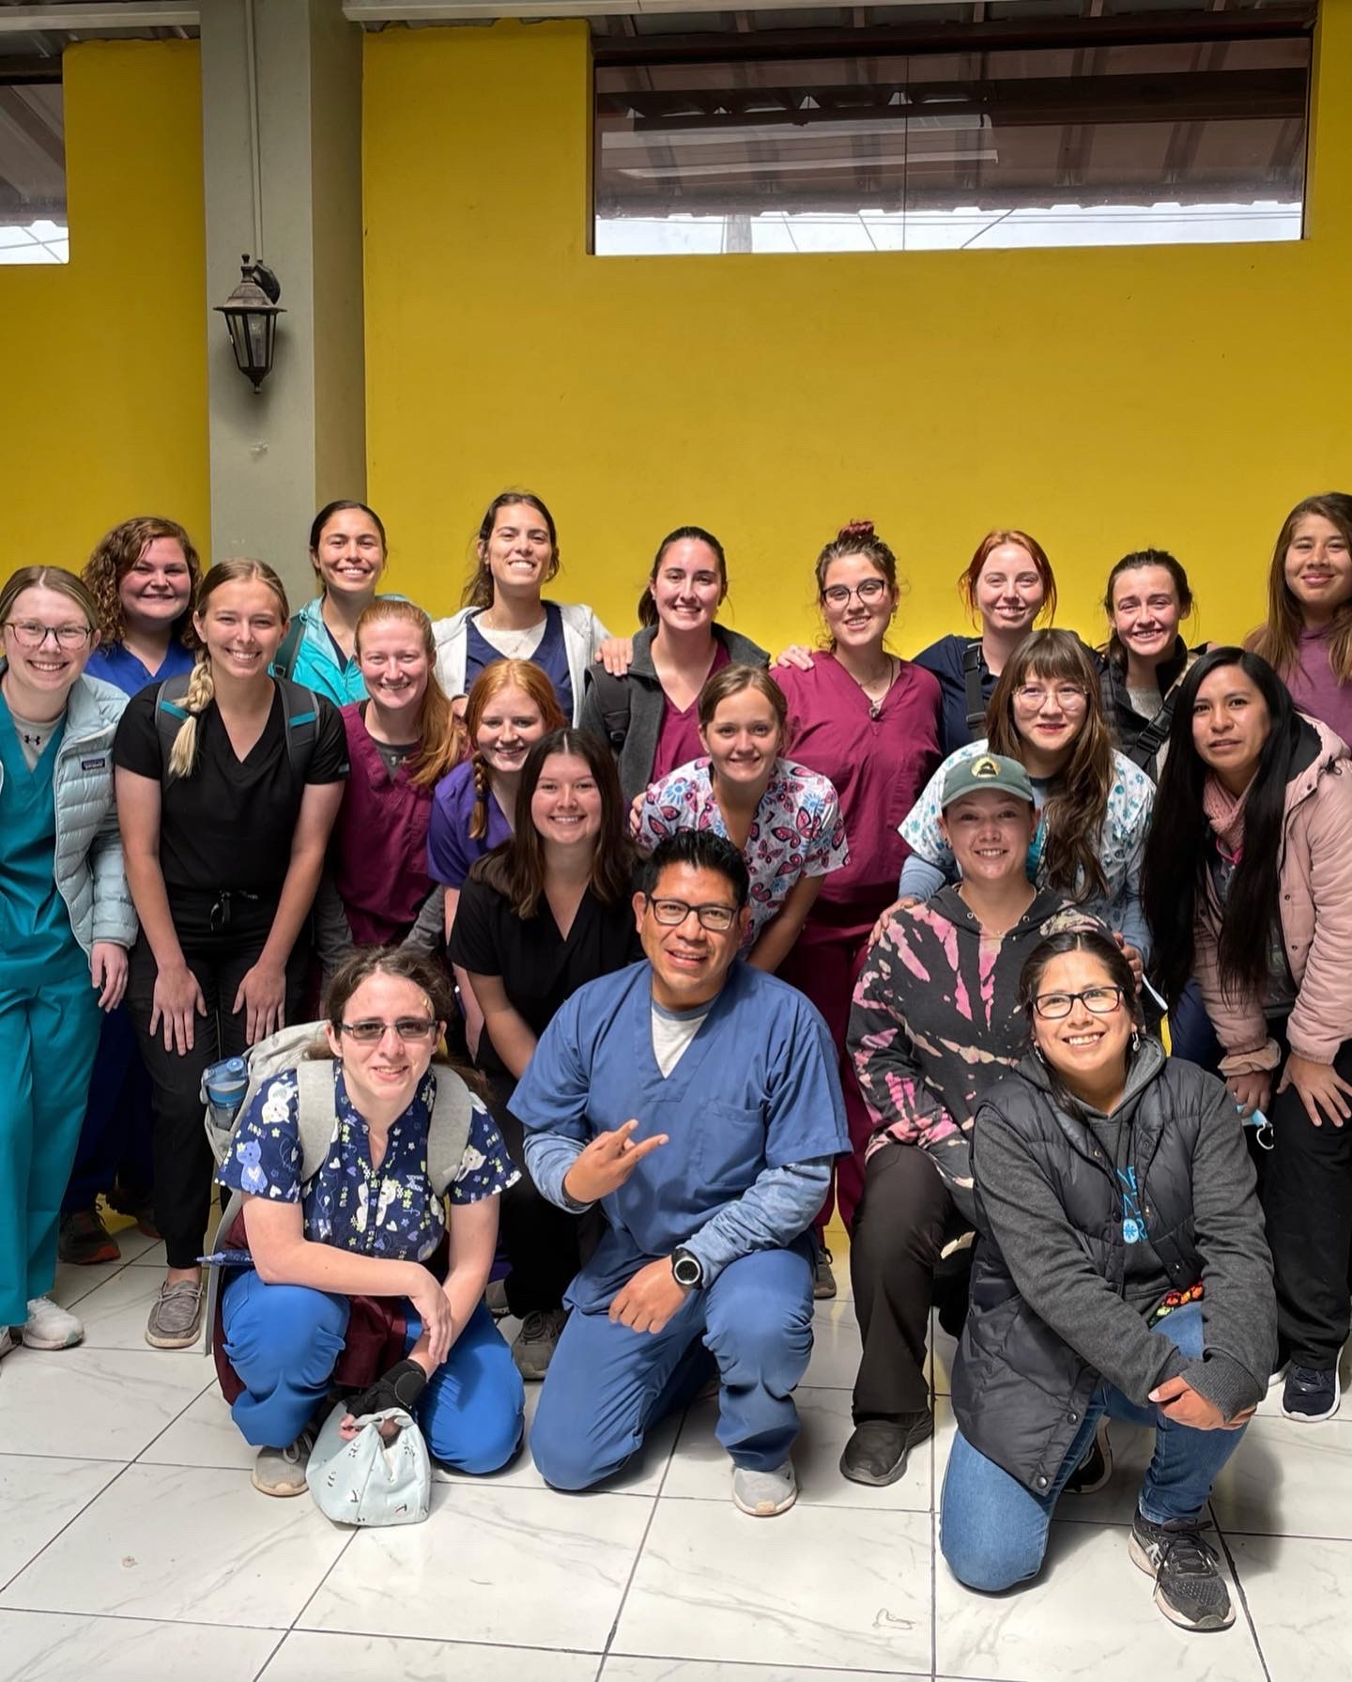
Symposium
Emma Davenport

Slide 17
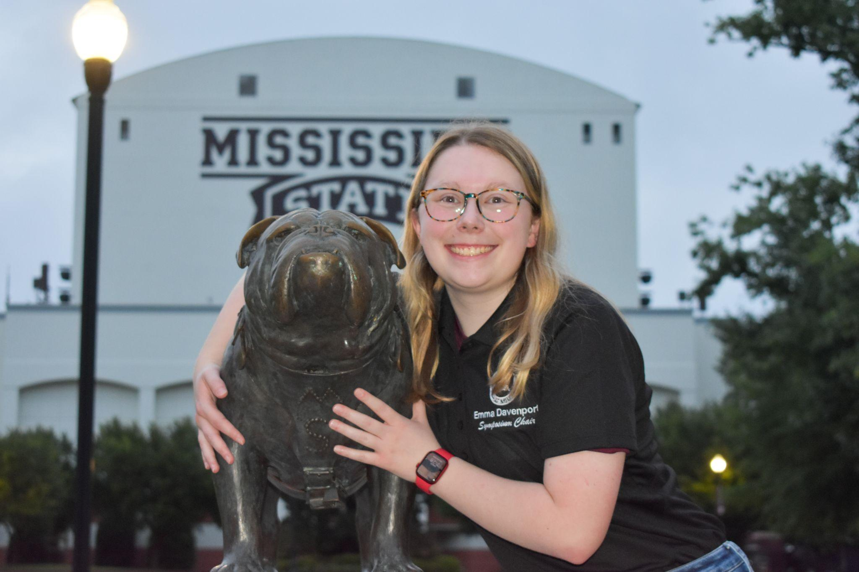
msupvcsymposium@gmail.com

Slide 18
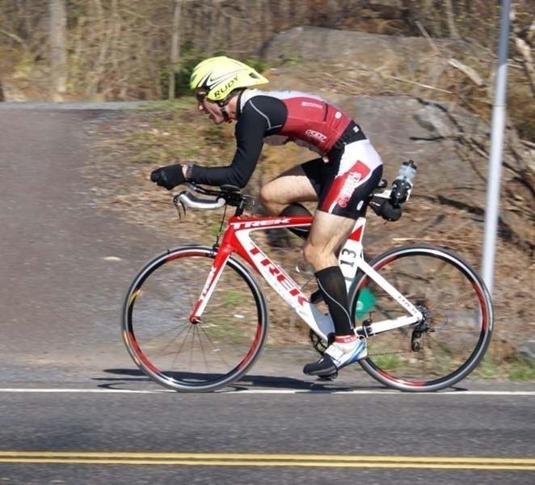
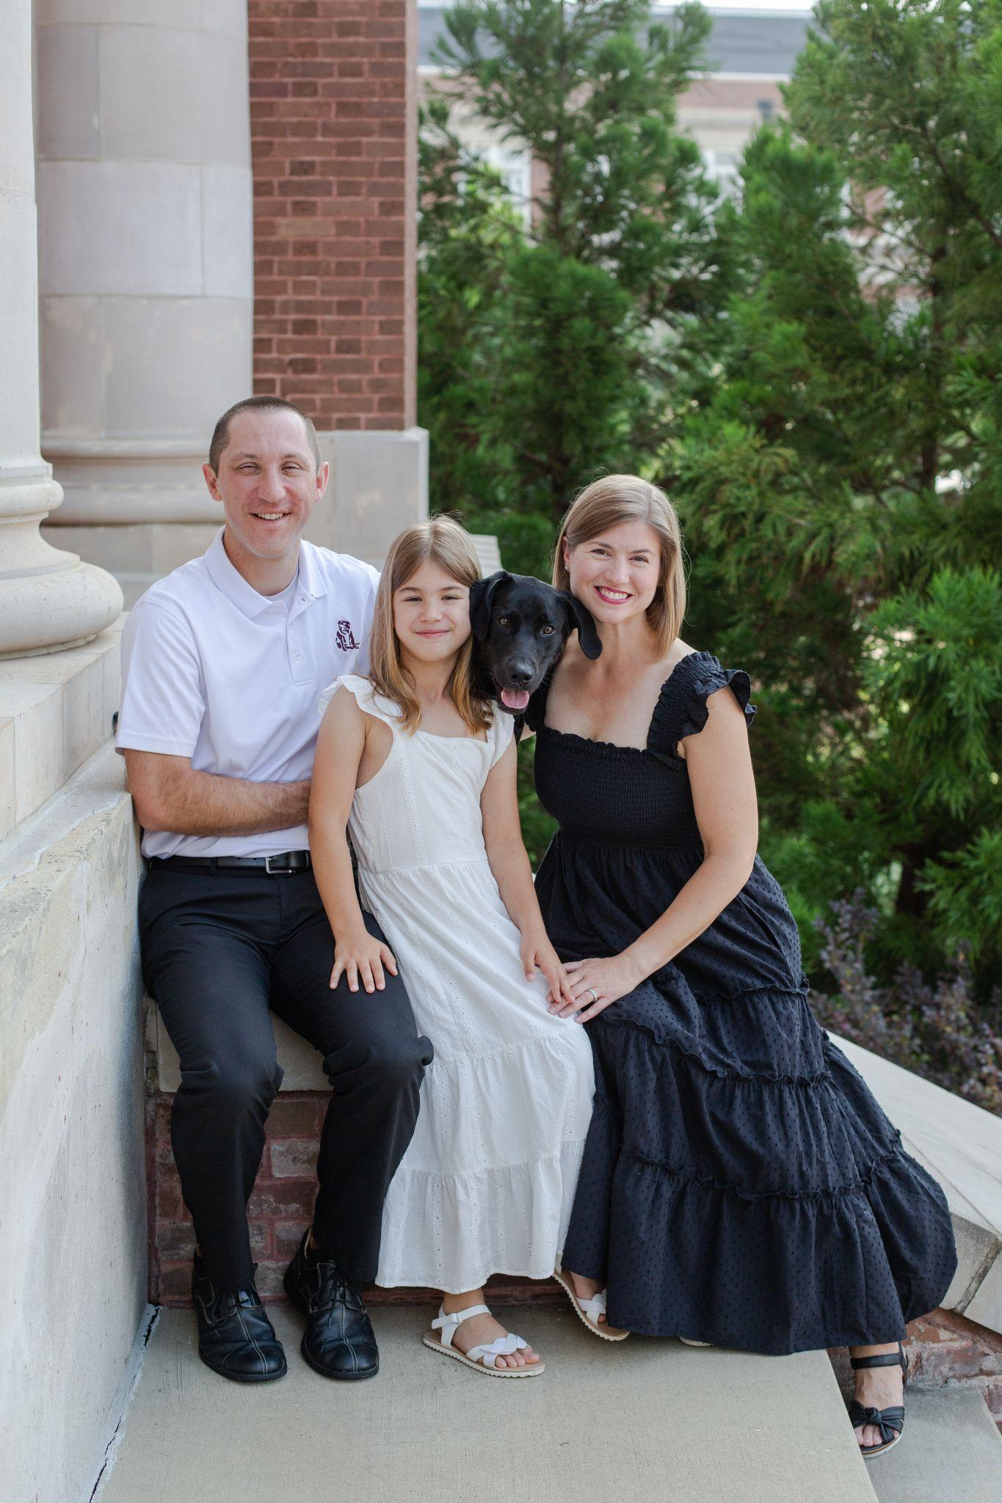
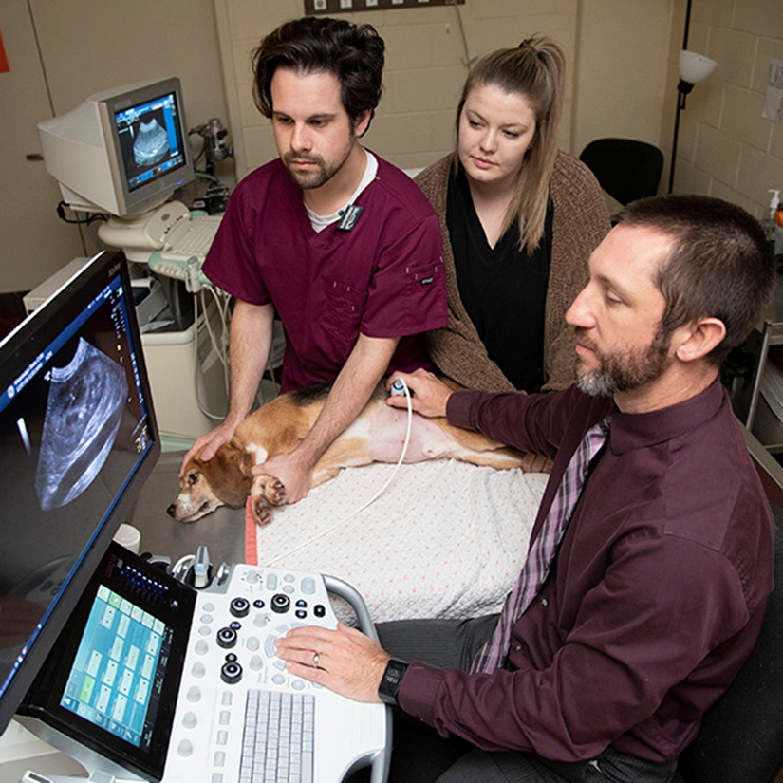
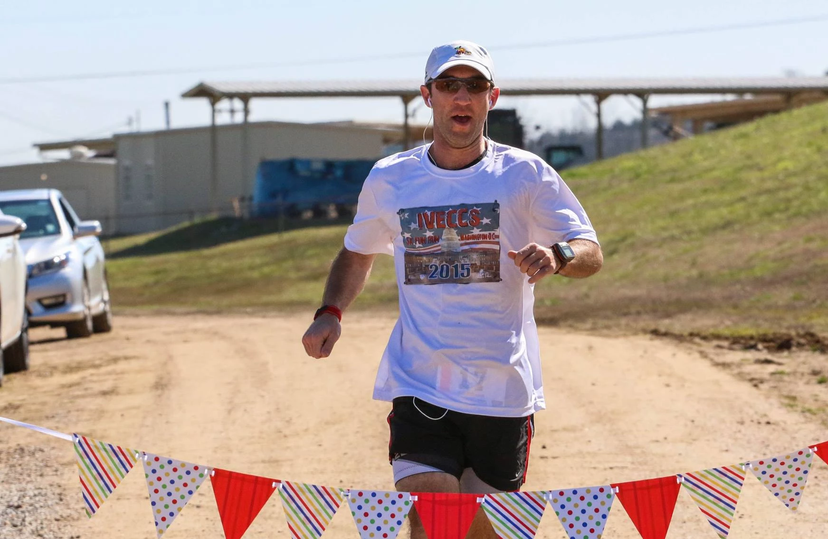
PVC Advisor
Dr. Marc Seitz

Slide 19
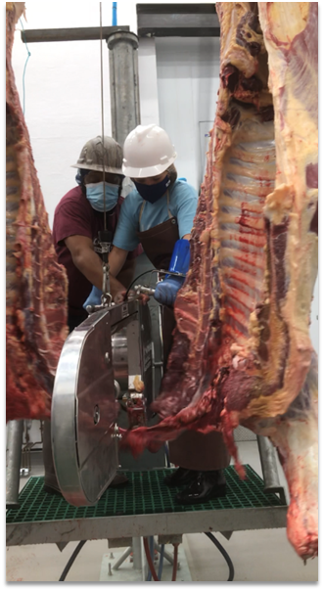
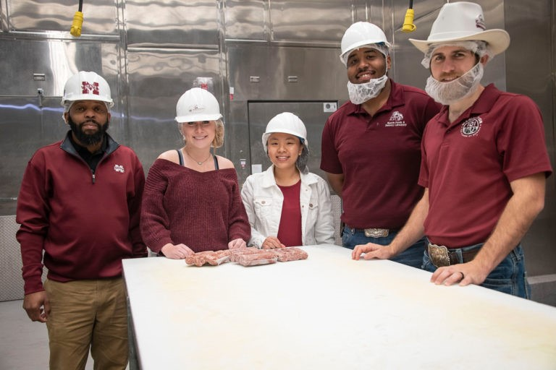


PVC Advisor
Dr. Derris Burnett

Slide 20
Historic Overview of The Club
General Body Meetings:
Dinner
Speaker
APVMA Symposium:
End of year trip
Academic Events:
Suture Labs
VMCAS Prep
Fundraiser:
Critters & Cornhole
Goat Yoga
Community Service:
OCHS Humane Society
West Point Humane Society
Homeward Bound

Slide 21


Slide 22
Membership Requirements
Active Membership:
Pay Dues ($20 per semester or $35 for the year by October 5th.)
Attend 4 of the 6 meetings per semester
4 Committee points (opportunities will be offered throughout the semester)
4 Service Hours (from pre-approved community service list)
Sell Tickets to Critters and Cornhole Tournament
Alternative Membership:
Pay Dues ($20 per semester or $35 for the year by October 5th.)
No meeting attendance is required, but email the Secretary a copy of your schedule/time conflict
5 Committee Points
5 Service Hours
Sell an additional 2 tickets to Critters and Cornhole Tournament

Slide 23
Community Service/Committees
Community Service Opportunities:
Oktibbeha County Humane Society
West Point Animal Shelter
Homeward Bound Transport/Cleaning Days
Committees:
Fundraising Committee (Courtney)
Public Relations Committee (Andrea)
Social Committee (Jessica)
Pup N’ Suds/Academic Workshop (Hannah & Zeta)
Symposium (Emma)

Slide 24

Fall Meeting Dates
September 7, 2022
September 21, 2022
October 5, 2022
October 19, 2022
November 2, 2022
November 16, 2022

Slide 25

GroupMe QR Code

Slide 26

Contact
Information
President | Hope Drake | msupvcpresident@gmail.com
Vice President | Courtney Storey | msupvcvicepresident@gmail.com
Treasurer | Zeta Mooney | msupvcvtreasurer@gmail.com
Secretary | Hannah Brasher | msupvcsecretary@gmail.com
Public Relations | Andrea Gonzalez Lopez | msupvcpublicrelations@gmail.com
Social Chair | Jessica Moroso | msupvcsocialchair@gmail.com
Webmaster | Madelyn Hunter | msupvcwebmaster@gmail.com
Symposium | Emma Davenport | msupvcsymposium@gmail.com

